Slide 1
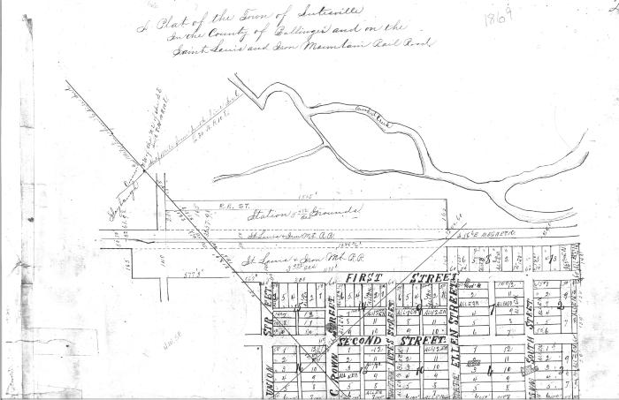
Section of 1869 Lutesville Plat Map (BCL-TOT-B-00006)

Slide 2
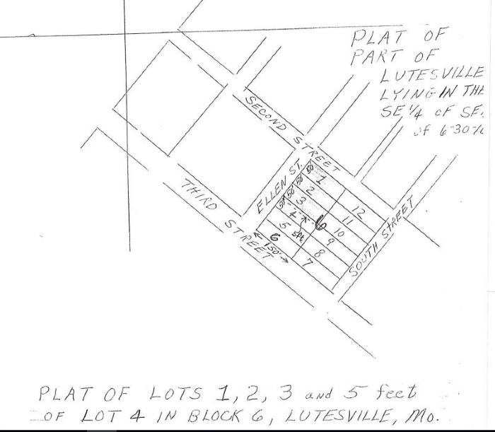
1837 Lutes House Location (BCL-TOT-B-00020)
;;The location of the Lutes house is shown on this section of the 1837 plat map of Lutesville (Marble Hill). The Lutes house was a witness structure to the Trail of Tears, as it was located along the Benge Route that passed through Marble Hill.

Slide 3
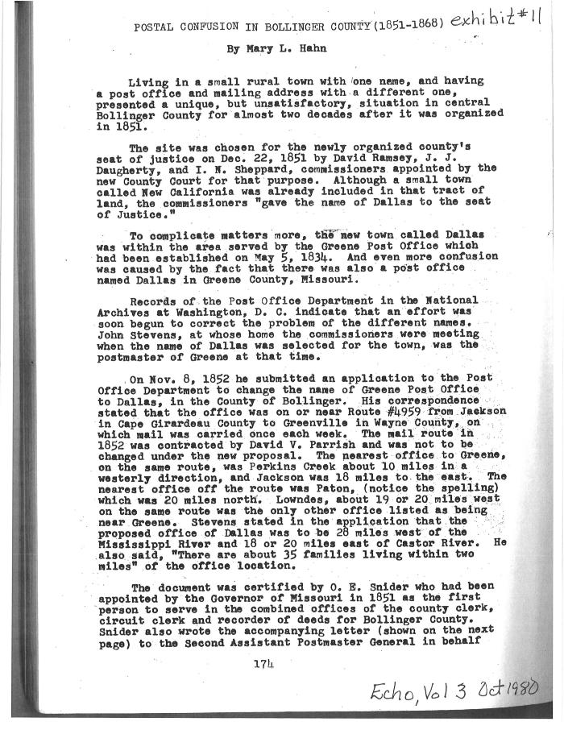
Hahn's Description of Greene Post Office (BCL-TOT-B-00027)
;;This document, titled "Postal Confusion in Bollinger County (1851-1868)", is an account by Mary L. Hahn of the renaming and building of a new post office in Bollinger County. The old post office's location is described to be "on or near Route #4959 from Jackson in Cape Girardeau County to Greenville in Wayne County", and this original building would've been a witness structure to the military/postal road that was part of the Trail of Tears Benge route. This establishes the presence of the Lutes family in the region, prior to the trial.

Slide 4
Lutesville Dollar Store and Flour Mill (BCL-TOT-B-00030)
;;This excerpt from Johannes Georg Lutz: 1706-1756 And His Descendants describes the location of the Dollar Store on Main Street and the flour mill run by Jacob Lutes in the first half of the nineteenth century. These would have been sites present when the Benge Route was used, passing through Lutesville (now called Marble Hill).

Slide 5
Copy of Bollinger County Land Entry Book (BCL-TOT-B-00037)
;;Bollinger County plat map showing the Lutesville/Marble Hill region, featuring the land owned by Jacob Lutes and the first families. The Benge route passed through this region, and the Lutes house was a witness structure on the Lutes property.

Slide 6
Original Land Patents of Bollinger County, MO (BCL-TOT-B-00038)
;;A list of names and associated plats of the people that first filed on the land from the Lutesville/Marble Hill region, listed as Township 30N Range 8E. Features Jacob Lutes 1849-1859.

Slide 7
Excerpt from "Bits of History" (BCL-TOT-B-00040)
;;This excerpt from Hahn's Bits of History describes the early history and first white settlers of Bollinger County, specifically the Lutesville region. John Lorance, Col. Bollinger, and Eli Deck are recorded as the first pioneers to settle in Lutesville and Glen Allen, Daniel Hahn settled at Possum Creek (then Hahn Creek). Later the Benge route of the Trail of Tears would pass through these settlers' properties. A photograph of a 1957 plaque commemorating the the founding history of Marble Hill and photos of the road between Lutesville and Marble Hill and the Swinging Bridge are also featured.

Slide 8
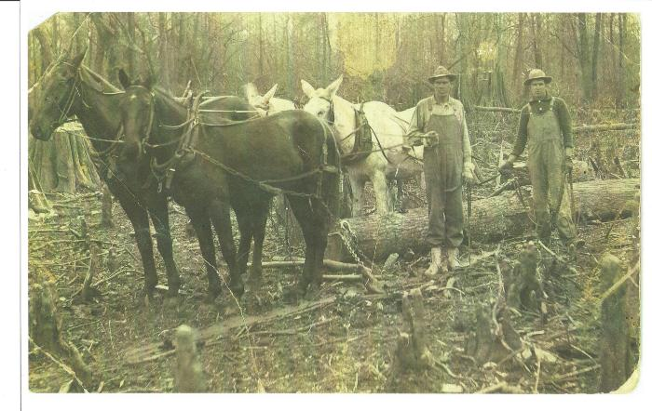
Bollinger County Timber Industry (boco-timber001)
;;Bollinger County Timber Industry Stave mills in Patton and Lutesville

Slide 9
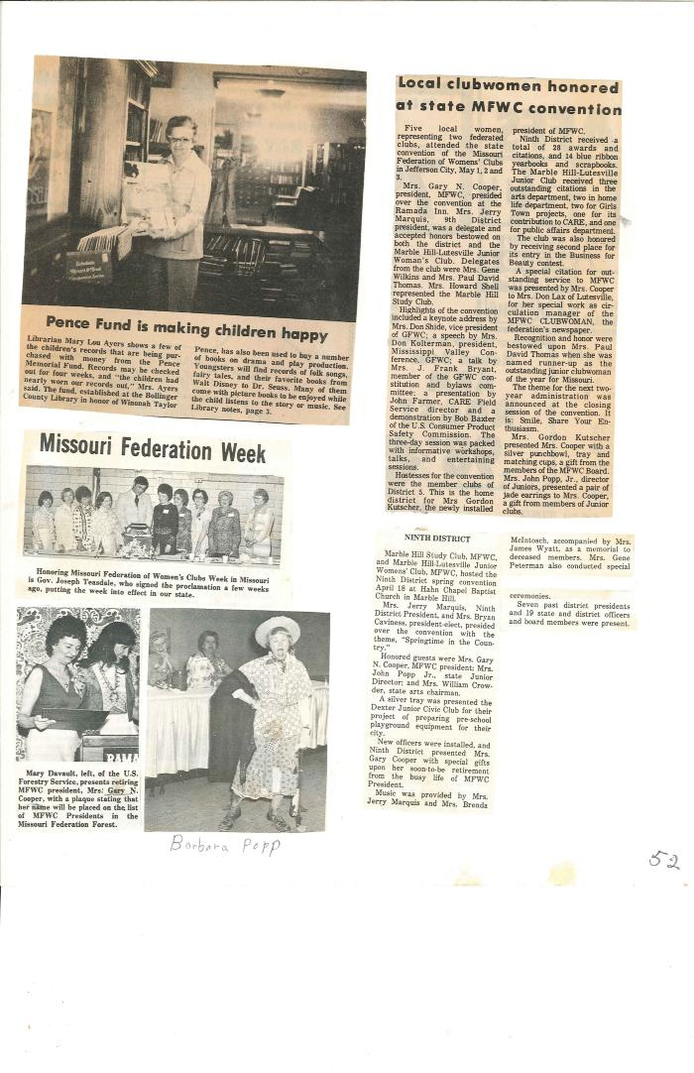
GFWC 1977-1978 Yearbook (bocolib-GFWC-00002)
;;1977-78 Yearbook GFWC of Marble Hill - Lutesville

Slide 10
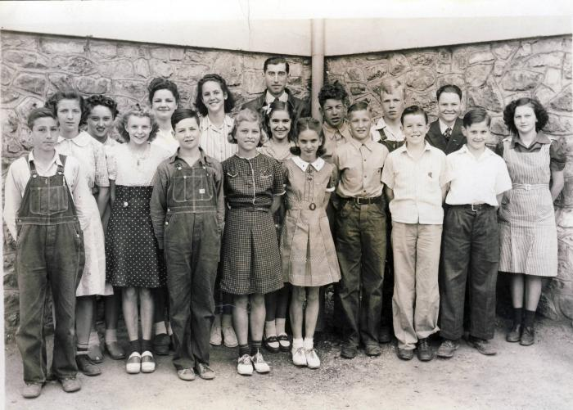
Lutesville School (bocolib-schools-00003)
;;

Slide 11
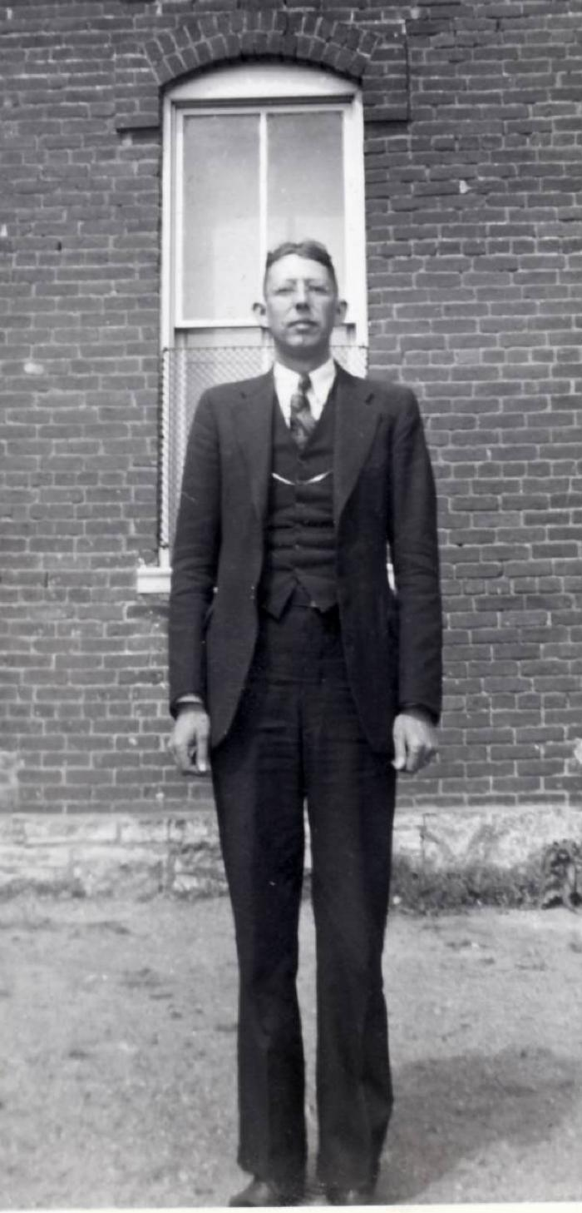
Chester Allen (bocolib-schools-00004)
;;Teacher: Chester Allen, English 1 & 2 and Speech Lutesville School

Slide 12
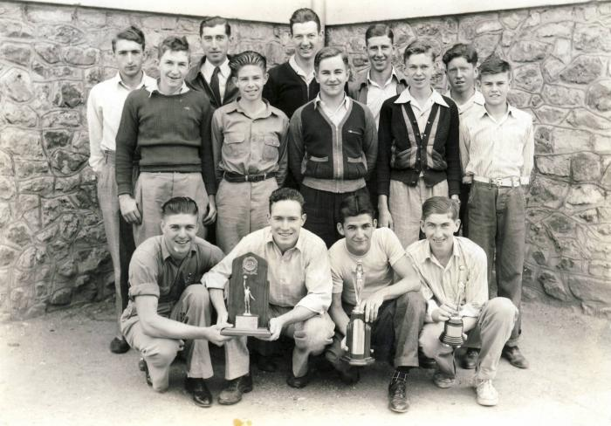
Lutesville School Basketball Team 1940-1941 (bocolib-schools-00005)
;;Basketball Team 1940-41 Left to Right First Row: Ray Dees, Bill Alexander, Tony Greer, Nippie Stone; Second Row: Dutchie Hilderbrand, Jack Choate, Jim Bill Higgins, Tuffy Fowler, Frankie Proffer; Third Row: _ Winifred - ?, Beryl Swan (coach), Robert Harlan, Lowell Stroup and Loyd (Red) Batan.

Slide 13
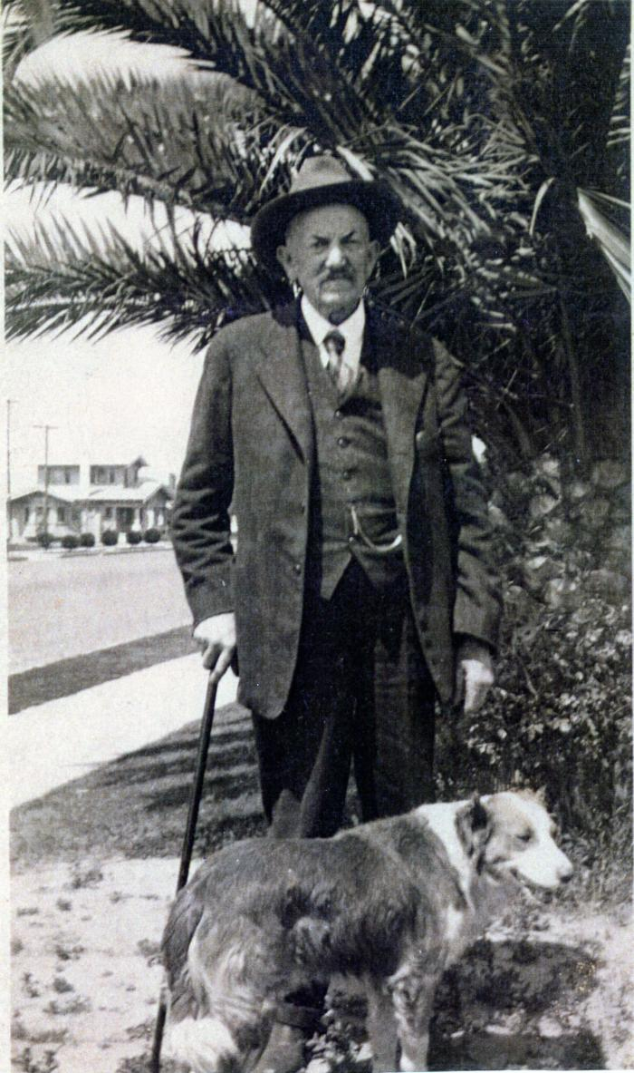
Eli Lutes and dog (pdthomas001)
;;Eli Lutes and dog Mr. Lutes gave the land where Lutesville was located in about 1867. This completed the transaction with the Iron Mountain Railroad to come through the area and locate a depot in Lutesville, Missouri.

Slide 14
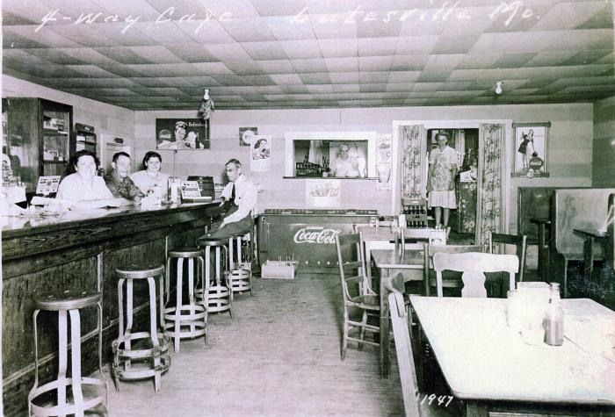
4-Way Café (pdthomas002)
;;4-Way Café Pearl and pit cook, Wilma Scott, Lucy Francis and Mrs. Kinder

Slide 15
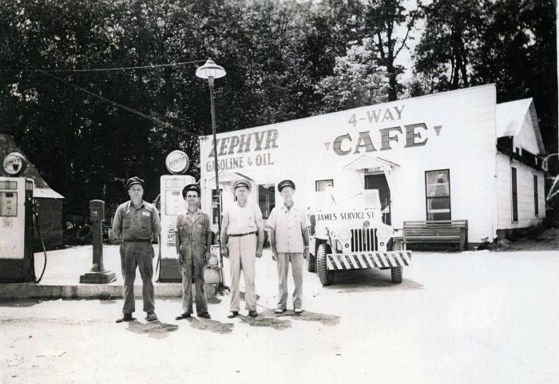
Zephyr Gasoline & Oil (pdthomas003)
;;Zephyr Gasoline & Oil Lindel James, Frank Ward, Harry Shetley, Hovie Scott

Slide 16
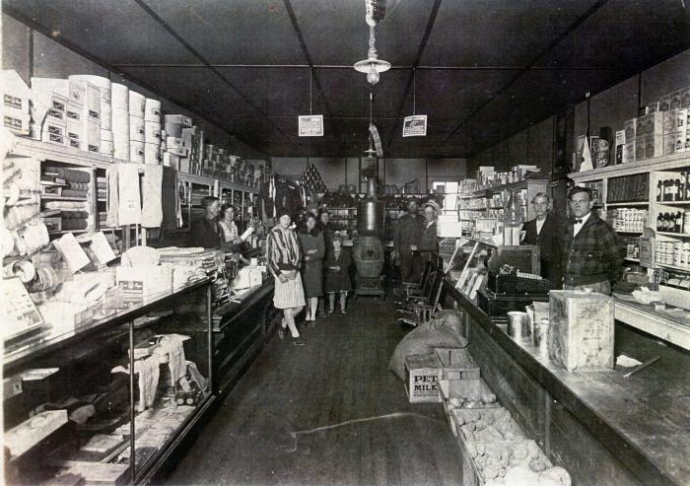
Barney Rockwell Store, 1924 (pdthomas004)
;;Barney Rockwell Store, 1924 First Street Left – John Cobble, foster parent of Barney Rockwell, 1st on far right Ruth Perkins Miller, 2nd on Left

Slide 17
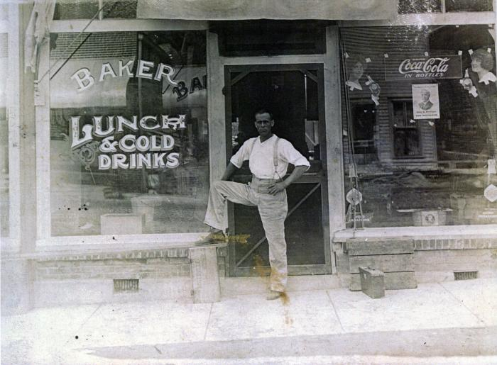
Baker Restaurant (pdthomas005)
;;Baker Restaurant AJ Baker

Slide 18
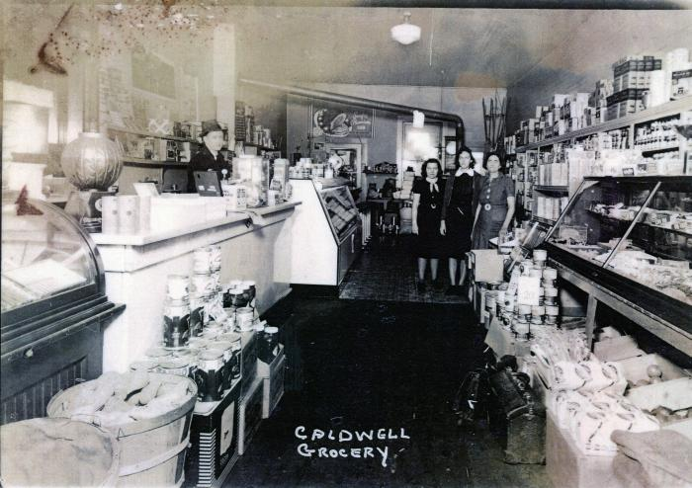
Caldwell Grocery (pdthomas006)
;;Caldwell Grocery on First Street Lutesville, MO Pictured from left to right salesman, Mary Crader, Bernie and Elsie Caldwell

Slide 19
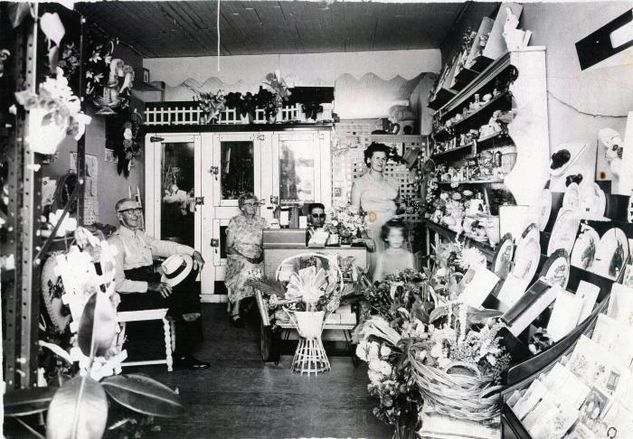
Mildred’s Flower Shop (pdthomas007)
;;Mildred’s Flower Shop on First Street Lutesville, MO Ephriam and Dora Bess and Howard, Mildred, and Dotta Shell

Slide 20
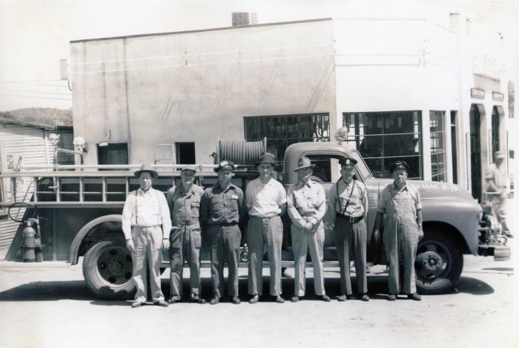
First Fire Truck (pdthomas008)
;;Lutesville’s first fire truck Pictured left to right Coy Shetley, T. R. Lewis, Lindel James, R. Smith, John D. Chandler, Harry Shetley and Buford Ward.

Slide 21
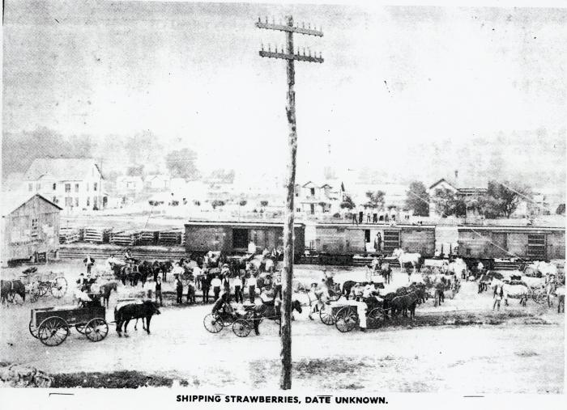
Shipping Strawberries (pdthomas009)
;;Shipping Strawberries - Lutesville MO Shipping locally grown strawberries via rail. Ricketts house facing Rail Road Street is in the right background

Slide 22
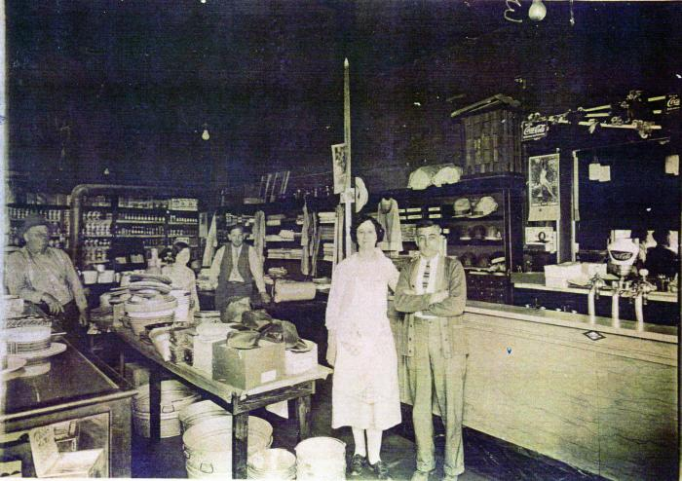
Eaker Store (pdthomas010)
;;Eaker Store - Lutesville MO Mr. & Mrs. Robert Eaker in their store on First Street. The building was formerly Peoples Bank.

Slide 23
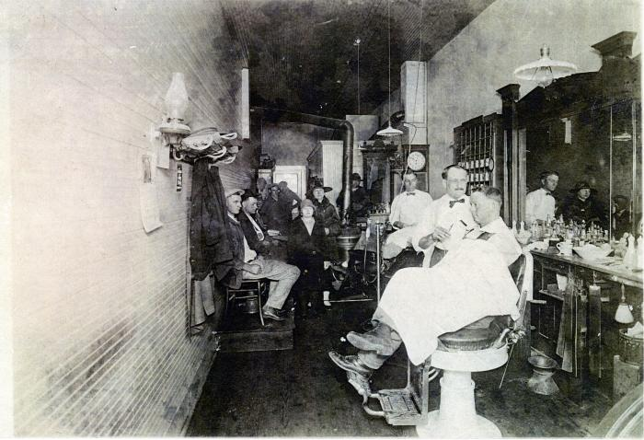
John Kinder's Barber Shop (pdthomas011)
;;John Kinder’s Barber Shop - Lutesville, MO John Kinder, barber, on right Earl Hartle, barber, on left

Slide 24
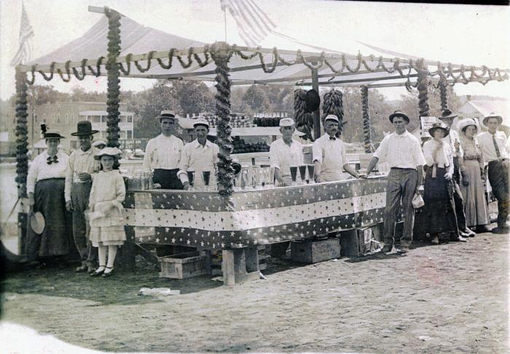
Picnic (pdthomas012)
;;Picnic in now “Rail Road” park. Large store building in background is at Railroad and Crown Street.

Slide 25
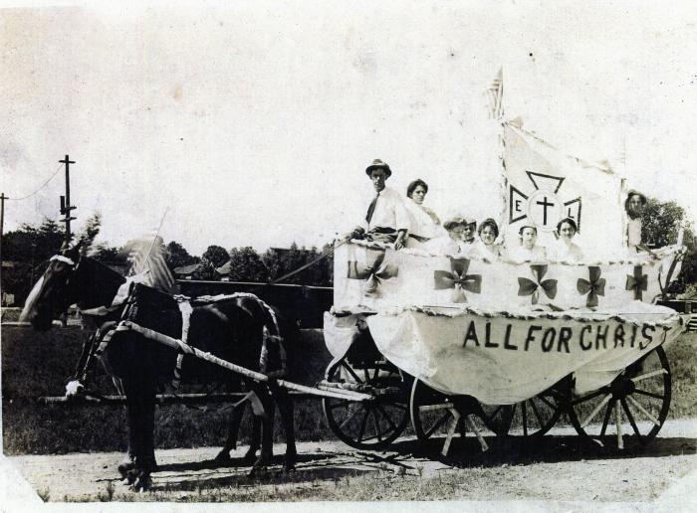
All for Christ - Horse drawn wagon (pdthomas013)
;;All for Christ - horse drawn wagon (float in parade)

Slide 26
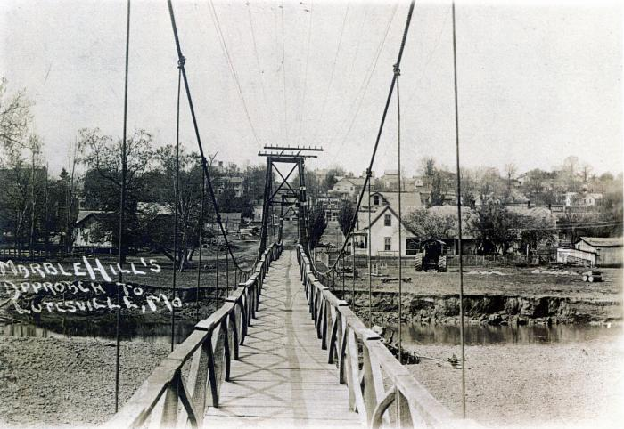
Swinging Foot Bridge (pdthomas014)
;;Swinging foot bridge approaching Lutesville from Marble Hill

Slide 27
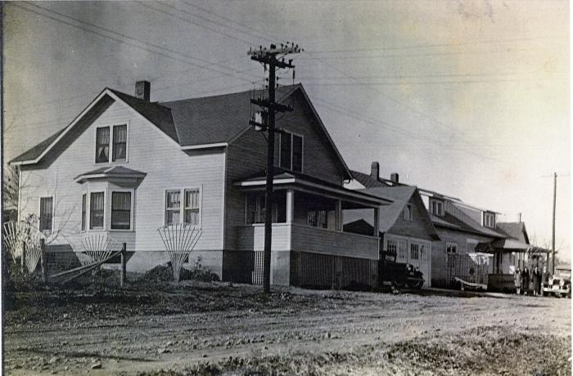
AJ Baker House & Funeral Home (pdthomas015)
;;AJ Baker House & Funeral Home (far right) - Lutesville MO

Slide 28
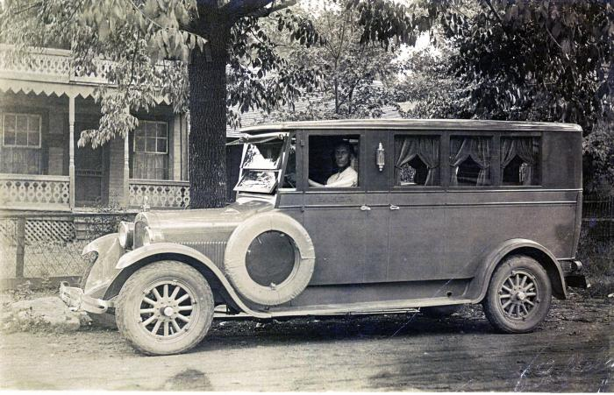
A. J. Baker in 1926 Dodge Hearse (pdthomas016)
;;A. J. Baker, 1926 Dodge Hearse, in front of Dr. William and Cora Lages residence on Union Street in Lutesville

Slide 29
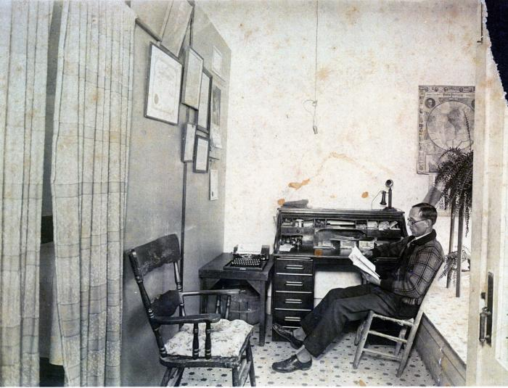
A. J. Baker (pdthomas017)
;;A. J. Baker in office reading

Slide 30
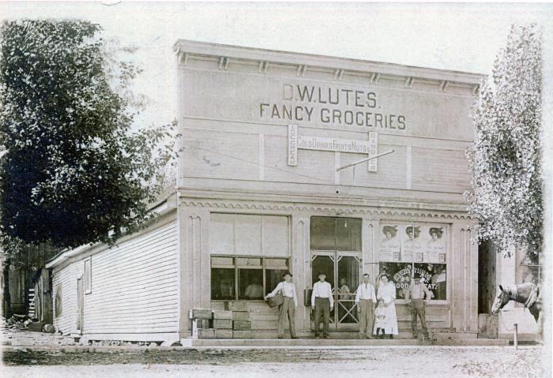
D. W. Lutes Fancy Grocery Store (pdthomas018)
;;D. W. Lutes Fancy Grocery Store, First Street, Lutesville in 1911 Advertisement on the signs reads, “Ice Cream”, “Cold Drinks”, “Fruits”, “Nuts”, “Candies", "Every Thing Good to Eat”

Slide 31
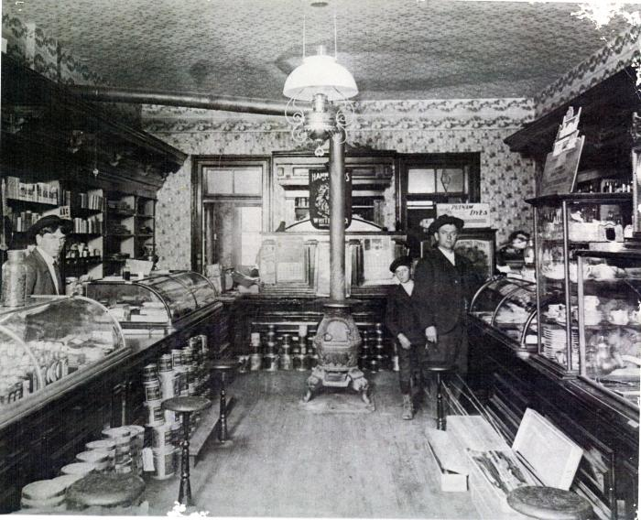
Chandler Drug Store (pdthomas019)
;;1903 Chandler Drug Store First Street, Lutesville

Slide 32
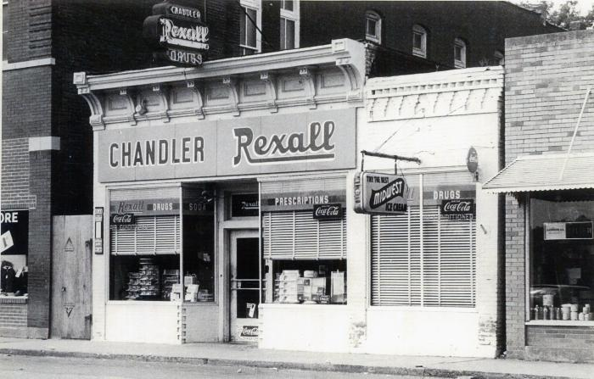
Chandler Drug Store (pdthomas020)
;;Chandler Drug Store - building was demolished on/about 2004

Slide 33
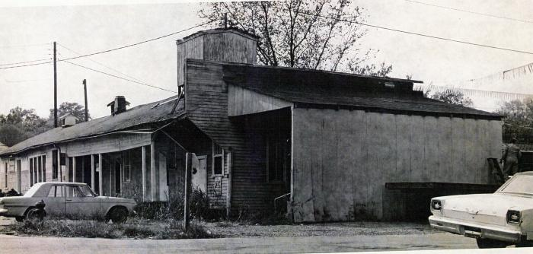
Lutesville MO (pdthomas021)
;;Tinnin Feed Store facing Crown Street near Railroad Street - Lutesville MO

Slide 34
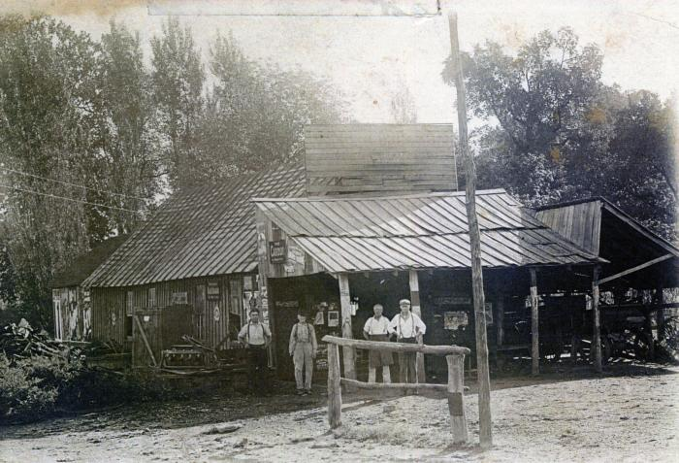
W. S. Burford & Son Black Smith Shop (pdthomas022)
;;W. S. Burford & Son Black Smith Shop - Lutesville MO Shown Wyatt Burford Sr., (unknown), W. S. and Jim Burford. An advertising sign reads “Cardui” which was a popular women’s drug at the time

Slide 35
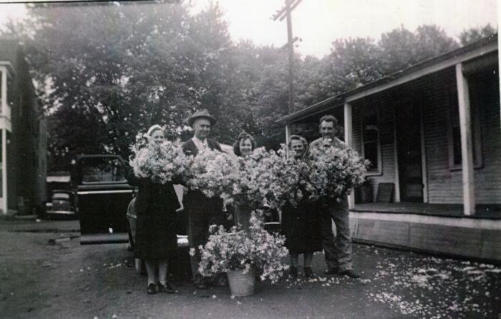
Lutesville Residents (pdthomas023)
;;Charles and Iva Lutes and Bessie and Mr and Mrs. Dines(?) Bess

Slide 36
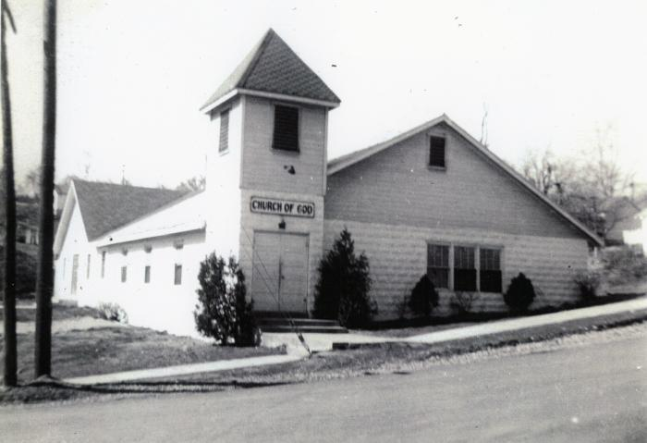
Church of God - Lutesville MO (pdthomas024)
;;Church of God - Lutesville MO Established 1930

Slide 37
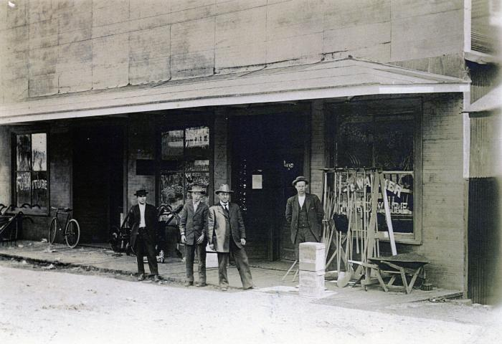
Walker Hardware (pdthomas025)
;;Walker Hardware - Lutesville MO A. B. and C. A. Walker, Troy

Slide 38
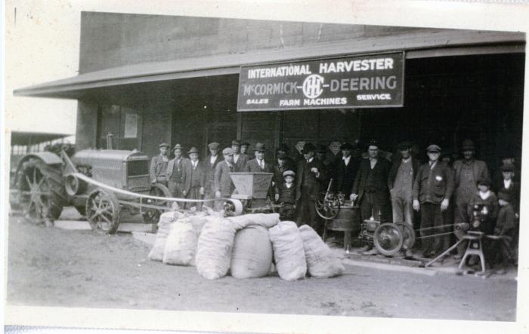
Walker Hardware Store (pdthomas026)
;;Walker Hardware Store, First Street Lutesville, MO demonstrating 1920 tractor & gasoline powered engine. Notice belt driven washing machine near the center of the picture "McCormick Deering Farm Machines" advertisement

Slide 39
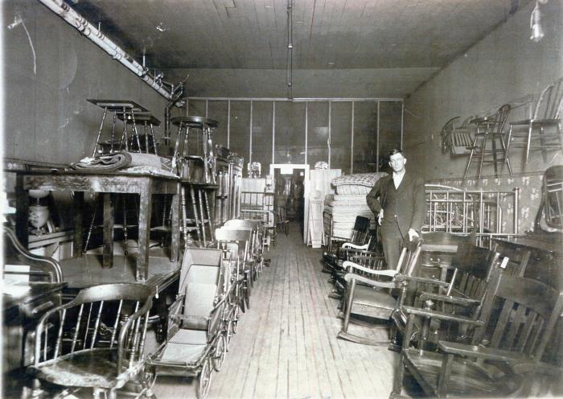
Walker Hardware (pdthomas027)
;;Walker Hardware Store (interior, First Street Lutesville MO Troy Francis, employee

Slide 40
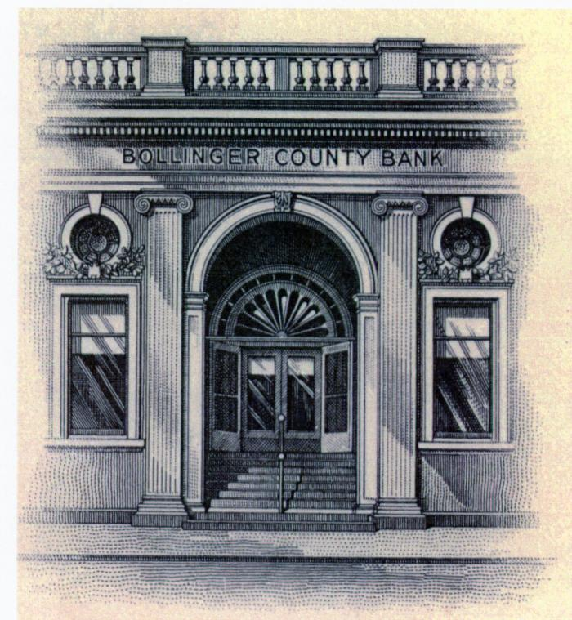
Bollinger County Bank (pdthomas028)
;;Sketch/Drawing - Bollinger County Bank -Lutesville MO original appearance, First Street, ca. 1890

Slide 41
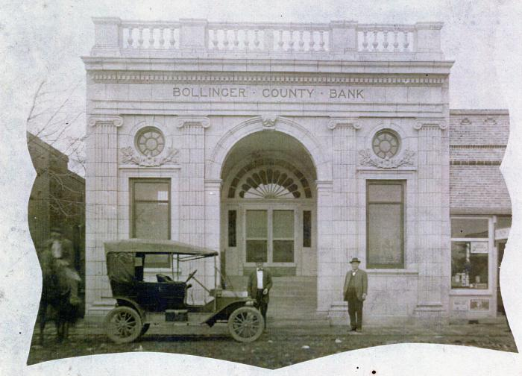
Bollinger County Bank (pdthomas029)
;;Bollinger County Bank -Lutesville MO

Slide 42
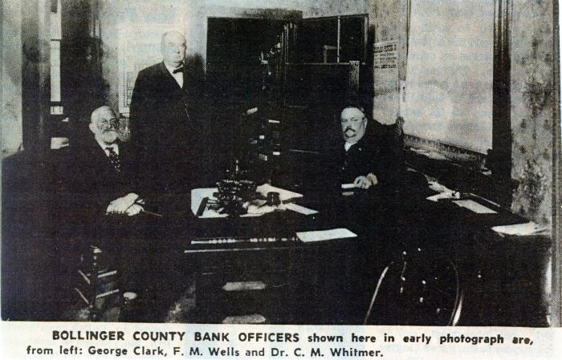
Bollinger County Bank Officers (pdthomas030)
;;Bollinger County Bank -Lutesville MO Officers: George Clark, F.M. Wells, Dr. C.M. Whitmer 1913

Slide 43
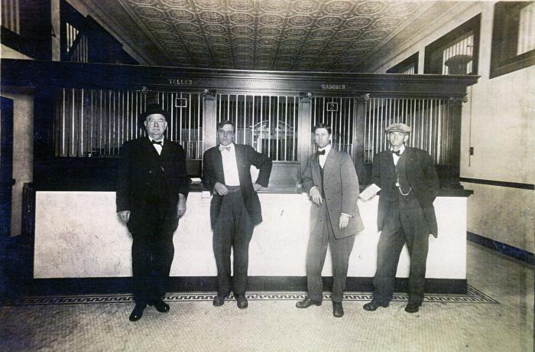
Bollinger County Bank (pdthomas031)
;;Bollinger County Bank -Lutesville MO Officers: F. M. Wells, S. E. Chandler, C. O Hobbs, and W. E. Dickey.

Slide 44
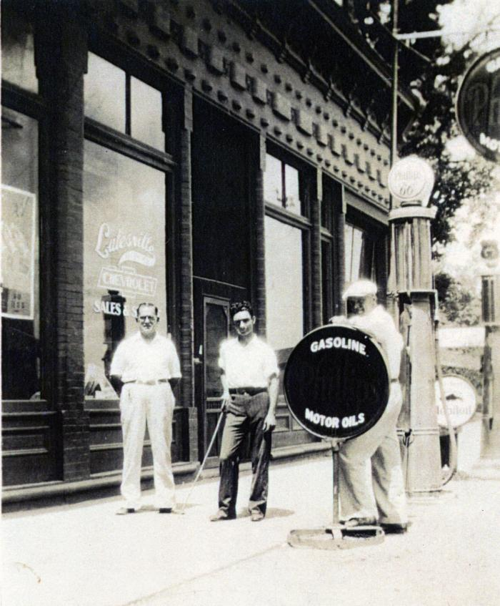
Lutesville Chevrolet Sales & Service (pdthomas032)
;;Lutesville Chevrolet Sales & Service - First Street Lutesville, MO Ben Burford, Sr., Charley G. Bollinger, “Hank” Bowman

Slide 45
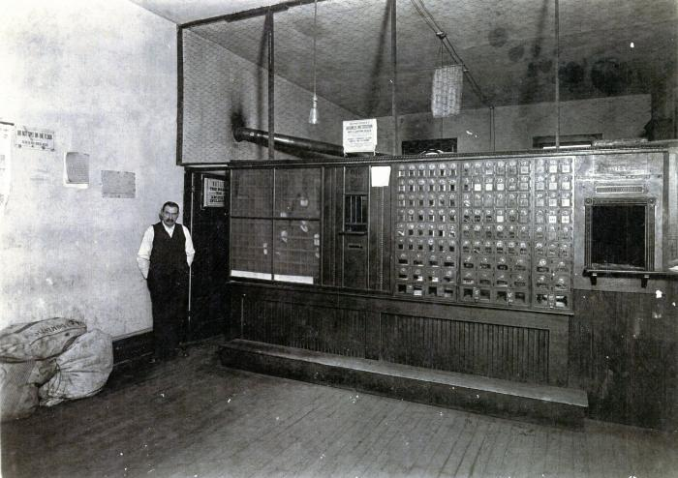
Lutesville Post Office (pdthomas033)
;;Lutesville Post Master Melvin Lutes, Sign on wall reads: “Do not spit on floor.” Sign above mailboxes says: “Business Institution, not a Loafing Place.”

Slide 46
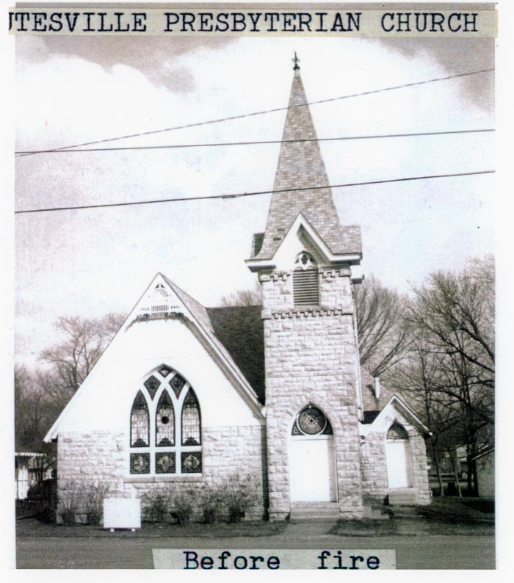
Lutesville Presbyterian Church (pdthomas034)
;;Lutesville Presbyterian Church - Before the fire

Slide 47
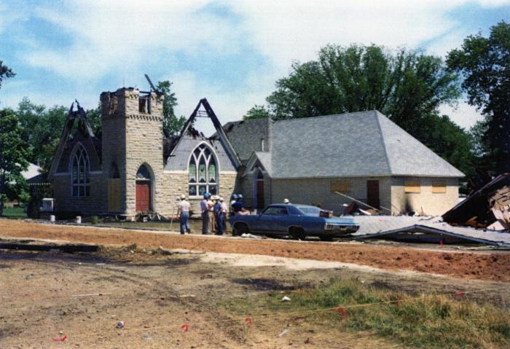
Lutesville Presbyterian Church (pdthomas035)
;;Lutesville Presbyterian Church - shortly after fire

Slide 48
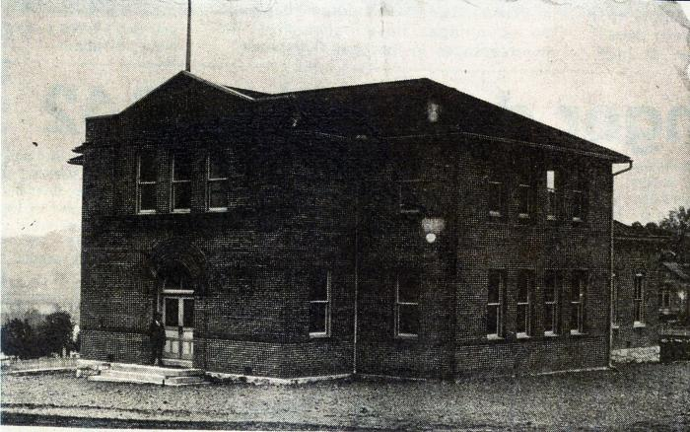
Lutesville School (pdthomas036)
;;Lutesville School - erected 1911

Slide 49
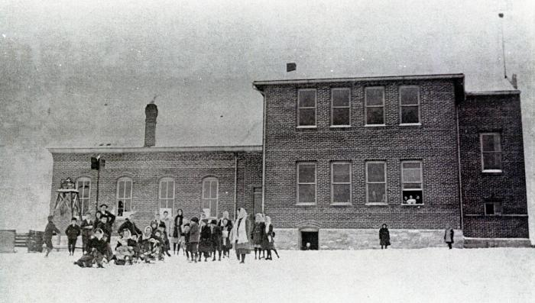
Lutesville School (pdthomas037)
;;Lutesville School - students in the snow as seen from side nearest to Crooked Creak

Slide 50
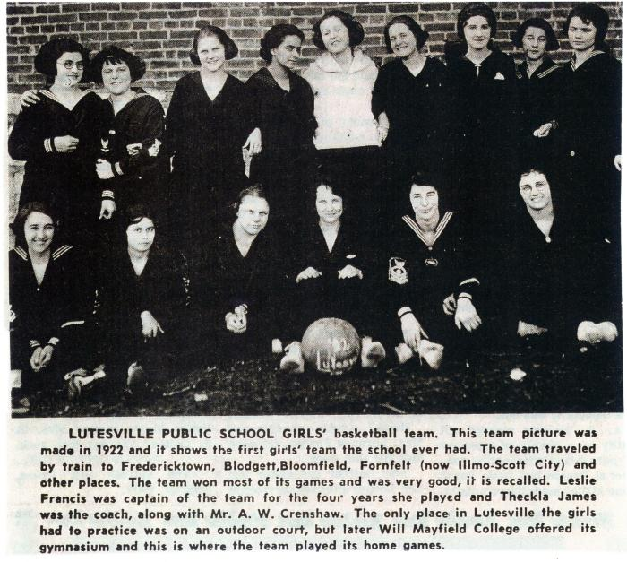
Lutesville Public School Girl's Basketball Team - 1922 (pdthomas038)
;;News article: Lutesville Public School Girl's Basketball Team - 1922 Captain: Leslie Francis Coaches: Theckla James, A.W. Crenshaw

Slide 51
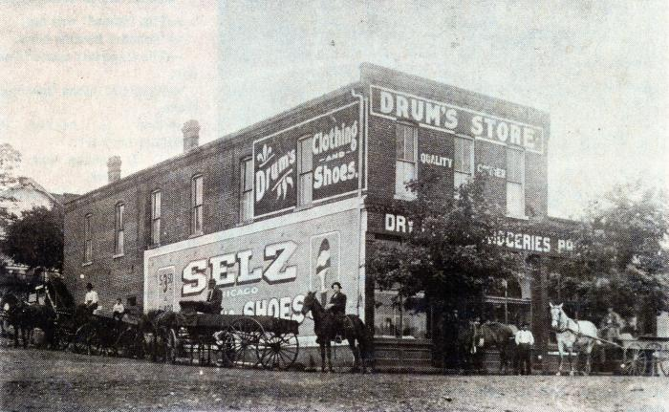
Drum's Store - Lutesville MO (pdthomas039)
;;Drum's Store - Lutesville MO Shoes & Clothes; Dry Goods; Groceries corner of Crown & 1st Streets

Slide 52
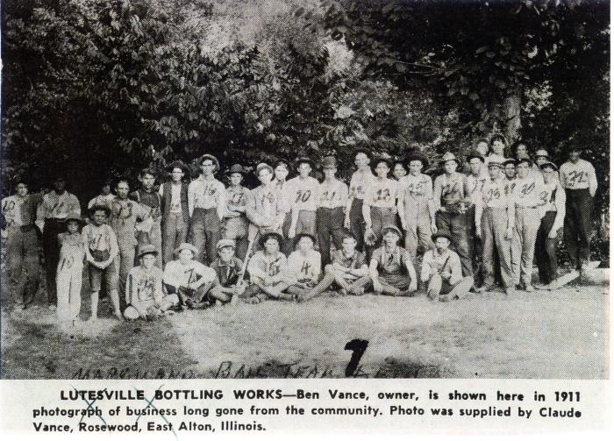
Lutesville Bottling Works - 1911 (pdthomas040)
;;Lutesville Bottling Works - 1911 Ben Vance - Owner Photo supplied by: Claude Vance - Rosewood, East Alton, IL baseball team

Slide 53
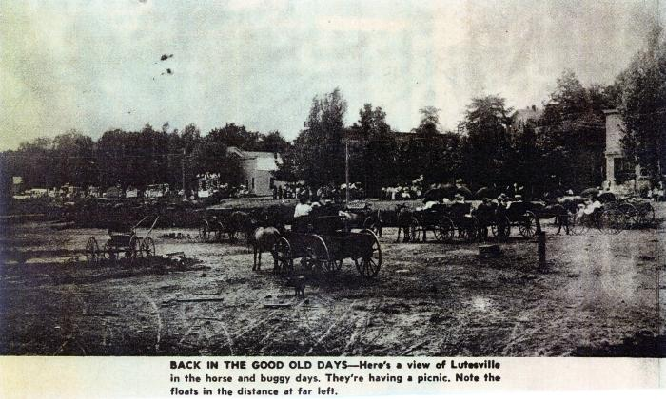
Old Lutesville (pdthomas041)
;;Old Lutesville - horses & buggies; parade; picnic looking towards First Street

Slide 54
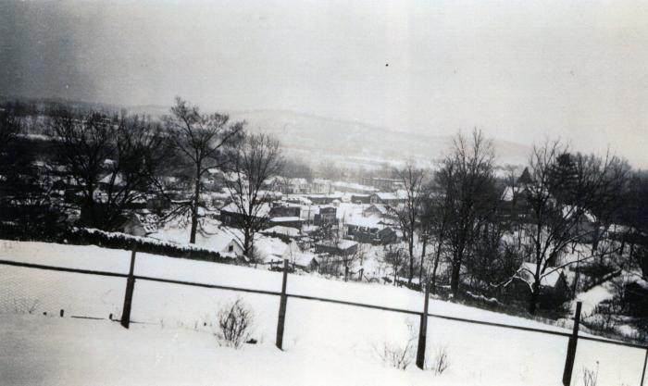
Lutesville - Winter Day (pdthomas042)
;;Lutesville - view over downtown from Main Street

Slide 55
SEMO (Southeast Missouri) Pallet Co. Truck (pdthomas043)
;;SEMO (Southeast Missouri) Pallet Co.Truck Glen Allen, MO Don Harris (driver) and Lester Phelps (owner) 1963 Glen Allen Pallet Factory

Slide 56
WW Sample House (pdthomas044)
;;First Picture: W. W. Sample residence next door to Sample Building on First Street - Lutesville, MO Second Picture: W.W. Sample residence when occupied by Willard Hastings Insurance

Slide 57
W.F. Hastings - 1904 World's Fair (pdthomas045)
;;W. F. Hastings at 1904 Louisiana Purchase Expedition also known as the St. Louis World’s Fair

Slide 58
Stave Mill Workers (pdthomas046)
;;Stave Mill workers near railroad in Lutesville, MO

Slide 59
Melvin Lutes Home - West Main Street (pdthomas047)
;;Post Master Melvin Lutes Home - West Main Street Lutesville, MO

Slide 60
Lutes Family (pdthomas048)
;;Lutes Family

Slide 61
Roy Underwood (pdthomas049)
;;Roy Underwood founder of Lutesville Motor; posing with automobile and gun Lutesville, MO

Slide 62
Early Lutesville Motor (pdthomas050)
;;Early Lutesville Motor, selling Dodge Bros. auto, on Railroad Street, by Burford’s, before Lutesville Motor Motor was owned by Underwood (?)

Slide 63
Chevrolet - Burford Motor CompanyBollinger County Oil Company (pdthomas051)
;;Burford Chevrolet on Railroad Street before Lutesville Motor R. W. Van Amburg, gasoline sales, Glen Burford, Jess Hahn, W. A. Butler, B. W. Burford Bollinger County Oil Company truck

Slide 64
Kirkpatrick Garage (pdthomas052)
;;Kirkpatrick Garage - Lutesville MO

Slide 65
Cooper Garage (pdthomas053)
;;Leo Cooper at Cooper Garage on Main Street near Crooked Creek. Lutesville MO

Slide 66
Cooper Garage (pdthomas054)
;;Cooper Garage - Main Street Lutesville MO Billy Stephens, Leo Cooper, Joe Johnson

Slide 67
Cooper Garage (pdthomas055)
;;Leo Cooper Garage - Main Street Lutesville MO near Crooked Creek

Slide 68
First Street (pdthomas056)
;;First Street - Lutesville MO Tallest Building (center): I.O.O.F. Lodge

Slide 69
Crooked Creek Flood (pdthomas057)
;;Crooked Creek - Lutesville, MO flood at Railroad and Crown Streets Burford Store

Slide 70
Eaker & Caldwell Store - November 1926 (pdthomas058)
;;November 1926 P.J. Eaker & T.A. Caldwell Store

Slide 71
Harry Shetley Service Station (pdthomas059)
;;Harry Shetley Service Station - 1944 Zephyr Gas

Slide 72
Sample Store Receipt (pdthomas060)
;;Sample Store receipt Lutesville MO WW Sample Alfred Shell & Bessie Williams

Slide 73
The Village Ice Cream Place (pdthomas061)
;;The Village Ice Cream Place - Lutesville ,MO Allie & Bill Charles, Troy Anderson

Slide 74
Lutesville Lodge 385 Parade Float (pdthomas062)
;;Lutesville Lodge 385 Parade Float 1911

Slide 75
Burford Store Parade Float (pdthomas063)
;;Burford Store parade float - lutesville mo Peter's Weatherbird shoes advertisement

Slide 76
Marble Hill - Lutesville Bus (horse and carriage) (pdthomas064)
;;Marble Hill - Lutesville Bus (horse and carriage) People's Bank Union and First Street

Slide 77
Rail Road and Logging Industry (pdthomas065)
;;Scene from railroad with Dickey’s (Dickie’s?) Store at far left, People’s Bank at left of center and Methodist Church at top of center. Lutesville, MO

Slide 78
People's Bank (pdthomas066)
;;People's Bank Grocery store Unique Sign "$5.00 Fine for Hitching to these trees"

Slide 79
Post Card (pdthomas067)
;;People's Bank Post Card - 1909 To: Mrs. M.S. Miller - Lodge, MO From : her daughter? (signature illegible)

Slide 80
People's Bank (pdthomas068)
;;Since there is no bank sign, perhaps it was before the bank was operating. The trees are smaller than in later pictures of the bank. Notice the sign below far right advertising “Coffins”. Windows in center are covered with protective covering as if during construction.

Slide 81
Lutesville Iron Mountain Rail Road Depot (pdthomas069)
;;Lutesville Iron Mountain Rail Road Depot with Western Union Telegraph sign

Slide 82
Railroad returns to Marble Hill (Old Lutesville) (pdthomas070)
;;Railroad returns to Marble Hill (Old Lutesville) photo of old caboose December 4, 1998; Paul David Thomas

Slide 83
Fletcher Service Station (pdthomas071)
;;Leo Fletcher Service Station

Slide 84
Dickey's Flour Mill 1920 (pdthomas072)
;;Dickey's Flour Mill 1920 Paint crew pictured: Wood & Clay

Slide 85
First Street - Lutesville 1913 (pdthomas073)
;;First Street - Lutesville July 1913 Farmers' and Merchants' Bank Post Office Barber Shop Undertaker Ward's Supermarket Western Auto Drum's Hall

Slide 86
Maude Kirkpatrick "Eat Shop" (pdthomas074)
;;Maude Kirkpatrick's Eat Shop 1943 First Street Lutesville MO Pevely Ice Cream

Slide 87
Maude's Dress Shop (pdthomas075)
;;Maude Kirkpatrick's Dress Shop 1943 First Street Lutesville, MO

Slide 88
Central Hotel (pdthomas076)
;;Central Hotel - Lutesville

Slide 89
Lutesville Businessmen - D.W. Burford General Store (pdthomas077)
;;n, L-R: R. L. Eaker, D. W. Burford, W. A. Leaffler(Loeffler), Jake Smith, Perry Eaker in front of D. W. Burford General Merchandise Store on First Street.

Slide 90
D.W. Burford General Store (pdthomas078)
;;D.W. Burford General Store Lutesville Frank Hopkins, “Drummer“ (salesman), Ike Francis, George B. Myers, D. W. Burford (owner), Perry Eaker and Homer Phelps at D. W. Burford’s Store on First Street

Slide 91
Burford & Eaker General Store (pdthomas079)
;;Burford & Eaker General Store - Lutesville, MO First Street, Farmer’s & Merchant’s Bank on corner, Union Street at right.

Slide 92
Taylor Mercantile Co (pdthomas080)
;;Taylor Mercantile Co - Lutesville, MO Railroad & Crown Street

Slide 93
Clark Hardware (pdthomas081)
;;George Clark, Sr., Hardware - Lutesville MO

Slide 94
Johnson Store & Restaurant (pdthomas082)
;;Johnson Store & Restaurant Mr. & Mrs. Noah Johnson (brother of Lena Harvey & Lottie Huff) "Restaurant, Groceries, and Lunch"

Slide 95
Ford Motors (pdthomas083)
;;First Picture: Ford Tractor, Later Lutesville Motor on Railroad Street and Charlie Wallis’ store in brick building. Second Picture: Roy Underwood, owner, Lutesville Motor Company on Railroad Street

Slide 96
Lutesville Methodist Church - Men's Sunday School 1922 (pdthomas084)
;;Men's Sunday School Class of Lutesville Methodist Church 1922 Front row (L-R): Harry Hawkins, Troy Mouser, Bob Phelps, Wilbur Eaker, Smtih Gladdish 2nd Row (L-R): Dr. R.W. VanAmburg, Norma Croft, Jesse B Lutes, Walter Buford, John F Willis, Roger Chandler, Charles Lutes 3rd Row: Nelson Henry, minister; Will Dunn, Perry Eaker, James Barks, Pink Taylor, Alex Hahn, unknown, Fred Mabuce, Henry Shell; 4th Row: Wm Abernathy, W.C. Cole, unknown, Mr. Sickmann, A.J. Baker, Troy Francis

Slide 97
Women's Sunday School Methodist Church of Lutesville 1921 (pdthomas085)
;;Women's Sunday School Methodist Church of Lutesville 1921 Front: Mrs. Mariam Pulliam, Mrs. Jessie B. Lutes, Mrs. Pink Taylor, Mrs. Troy Mouser, Mrs. Henry Shell Back: Mrs. Harry Hawkins, Mrs. Fred Mabuce, unknown, Mrs. Norma Croft, Mrs. Rosie McGirel, unknown, Mrs. Sickmann, Mrs. Lucy Phelps

Slide 98
Church of God - Lutesville (pdthomas086)
;;Church of God Lutesville 1928 Pat Husky - Pastor Picture: Pearl Nanney

Slide 99
Dr. C.A. Sander Office (pdthomas087)
;;Doctor's Office Dr. C.A. Sander Eric Sander

Slide 100
Commercial Hotel (pdthomas088)
;;Commercial Hotel - Lutesville MO

Slide 101
First Steel Bridge - Crooked Creek (pdthomas089)
;;Gravel street and first steel bridge across Crooked Creek at flood stage

Slide 102
Swinging Foot Bridge over Crooked Creek (pdthomas090)
;;Swinging foot bridge over Crooked Creek. Perhaps opening day since there are so very many people on and beneath the bridge

Slide 103
Swinging Foot Bridge (pdthomas091)
;;Swinging foot bridge over Crooked Creek between Marble Hill and Lutesville

Slide 104
Swinging Foot Bridge - Crooked Creek (pdthomas092)
;;Swinging foot bridge over Crooked Creek between Marble Hill and Lutesville approaching Lutesville

Slide 105
1905 Laying of corner stone - Lutesville Presbyterian Church (pdthomas093)
;;1905 Laying of corner stone for Lutesville Presbyterian Church on Railroad Street

Slide 106
Lutesville Women's Club 1951 (pdthomas094)
;;Lutesville Women’s Club dining at the Alvarado Restaurant in Cape Girardeau August 30, 1951 Seated left to right Mary Elfrink, Marie Van Amburg, Mary Lou Ayers, Dora Gladish, Mrs. Guy Teeters, Ruth Croft, Pauline Clubb. Standing left to right Florence Myers, Mrs. W. W. Mathews, Lill Estes, Bessie Cooper, Viva Rogers, Allene Cobble, Mae Eaker, and Maude Chandler.

Slide 107
House on Railroad Street (pdthomas095)
;;House near Lutesville Presbyterian Church on Railroad Street.

Slide 108
1908 Railroad Street - Lutesville MO (pdthomas096)
;;1908 Railroad Street - Lutesville MO

Slide 109
Lutesville Methodist Church, Dickey’s Flour Mill, Presbyterian Church (pdthomas097)
;;Lutesville Methodist Church, Dickey’s Flour Mill, bottom – Presbyterian Church

Slide 110
Taylor Mercantile Store (pdthomas098)
;;Mr. Taylor in front of Taylor Mercantile Store on Railroad Street

Slide 111
Clark's Store (pdthomas099)
;;George A. Clark, Jr. Clark’s Store, Linus Hartle and Charles Lutes in front of their hardware store on First Street

Slide 112
Lutesville Residents (pdthomas100)
;;Avery Day, driving, Charley Day, George Clark (boy), C. P. Ricketts house on right, Railroad Street

Slide 113
C.P. Rickett's House (pdthomas101)
;;C. P. Rickett’s House, ca. 1868, Railroad Street. Oldest residence in Lutesville

Slide 114
Lutesville Northern Methodist Church (pdthomas102)
;;Lutesville Northern Methodist Church on Main Street near Crooked Creek at the intersection with Railroad Street

Slide 115
Early 1900s Twin City Annual Picnic Parade (pdthomas103)
;;1902/1903 Lutesville girls riding side saddle in Twin City annual picnic parade. Left to Right Grand Marshal, Sheriff Dolph King, Gertrude Biggs, Mayme Revelle, Maude Dale, Hattie Dale, Della Warren, Pearl Lutes, Jessie Phelps, Alpha Myrick, Alma (Burke) Hobbs, and Roy Drum

Slide 116
First Street in Lutesville (pdthomas104)
;;First Street in Lutesville

Slide 117
W.C. "Tobe" Cole & wife (pdthomas105)
;;W. C. “Tobe” Cole & wife in front of their residence (at far right) on Railroad Street

Slide 118
Cole’s “White Way” store (pdthomas106)
;;W. C. “Tobe” Cole and daughter, Flossie Cole Hartle, in Cole’s “White Way” store at the corner of First and Union Streets in former Farmers and Merchants Bank building. Store beginning was 1932

Slide 119
Poll Tax (pdthomas188)
Men working out their Poll Tax (required before they could vote) at the 1908 swinging foot bridge over Crooked creek between Marble Hill and Lutesville. About 1920. Sometimes young boys were hired to do the work by some of the men. Included in this group are: Plutarc/jConrad, Leon Sander, Benton Conrad, Emest Richards, Otto Sander, Joe Ledbetter, W. A. Davault, W. M. Welker, A. P. Crader, J. A. Richards, Otis Hahn, Bob Hatcher, W. A. Kinder, C. C. Conrad and other not identified.;

Slide 120
Poll Tax (pdthomas189)
"Poll Tax" workers below the 1908 swinging foot bridge, circa 1920. Bridge crossed Crooked creek between Marble Hill & Lutesville.;

