Slide 1
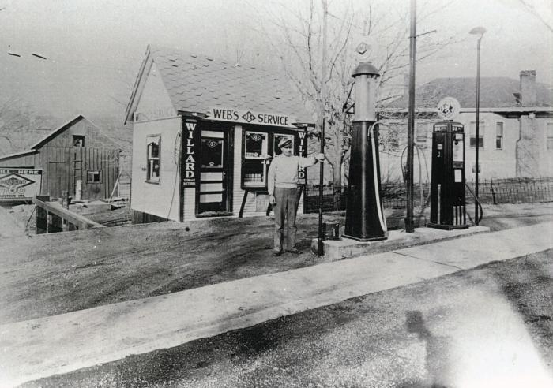
Webster Grimsley Service Station ()
Webster Grimsley service station 1936, later used as the first public library by Marble Hill Study Club, fore runner of the Bollinger County Library;

Slide 2
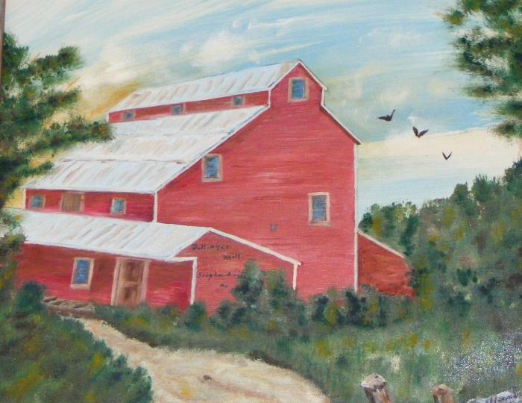
Bollinger Dolle Mill (bocolib-art-002)
;;Oil Painting - Bollinger Dolle Mill. Sedgewickville, MO By: Ted Hanners; Bollinger County Library

Slide 3
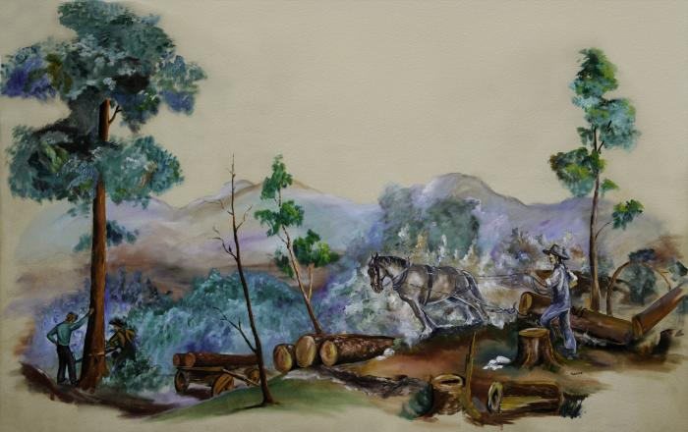
Logging in Bollinger County (bocolib-runnels-00001)
;;Photo of 1966 Tom Runnels mural that was located in old Library building at 302 Conrad Ave., Photo created because mural was painted on thin plaster wall and was not removable. 4 ft. x 6 ft. Photo by Leonard Fulbright;

