Slide 1
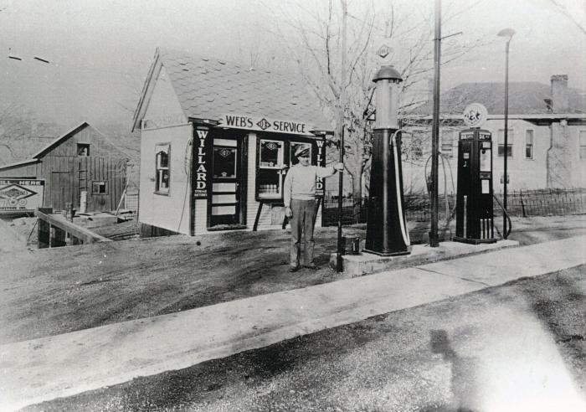
Webster Grimsley Service Station ()
Webster Grimsley service station 1936, later used as the first public library by Marble Hill Study Club, fore runner of the Bollinger County Library;

Slide 2
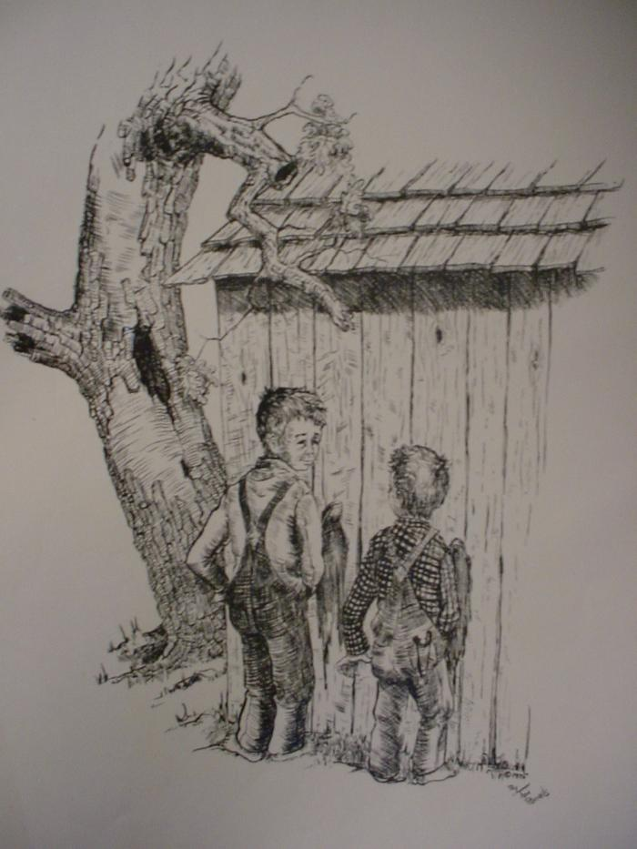
Tall Man Wins ()
Tall Man Wins drawing by Tom Runnels

Slide 3
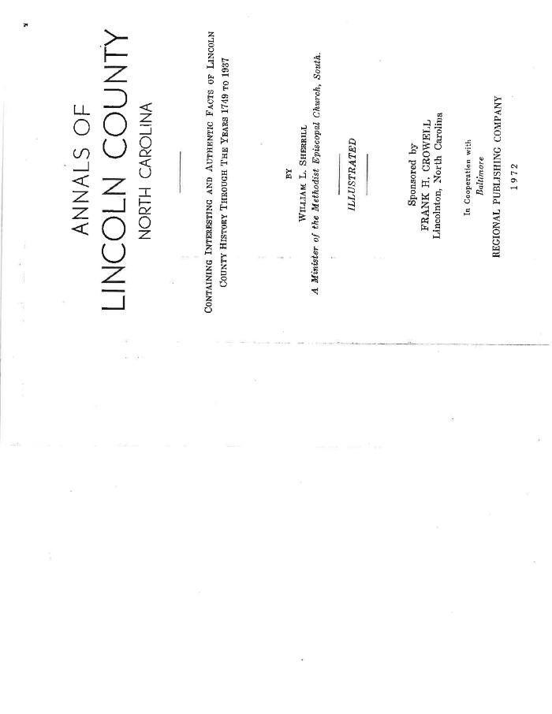
Annals of Lincoln County, North Carolinaby William L. Sherrill - A Minister of Methodist Episcopal Church South (Annals of Lincoln Co. NC)
Annals of Lincoln County, North Carolina by William L. Sherrill - A Minister of Methodist Episcopal Church South Containing interesting and authentic facts of Lincoln Co. history 1749-1937

Slide 4
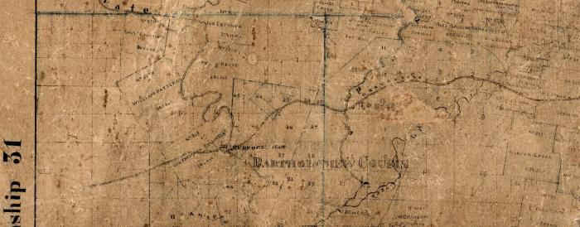
Section of 1870 Brooks Cape County Map (BCL-TOT-B-00001)
Scanned section of the 1870 James Brooks Cape County map showing Hwy 34 which was a "gravel road" established as a postal/family road in the 1790's, which became part of the Benge Route during the Trail of Tears.

Slide 5
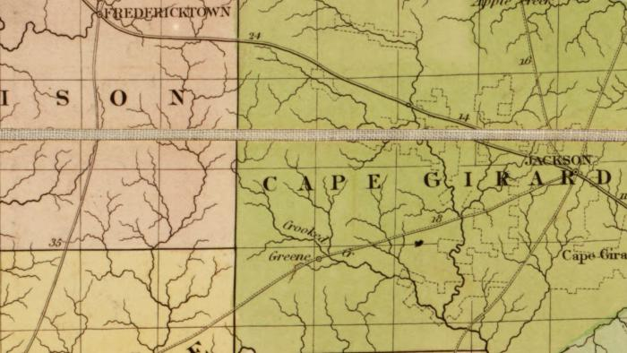
Section of 1839 Burr Postal Map (BCL-TOT-B-00002)
Scanned section of the 1839 Burr map showing the postal road from Jackson to the Greene (present-day Marble Hill) post office and southwest to Greenville. This postal road was a part of the Benge Route during the Trail of Tears.

Slide 6
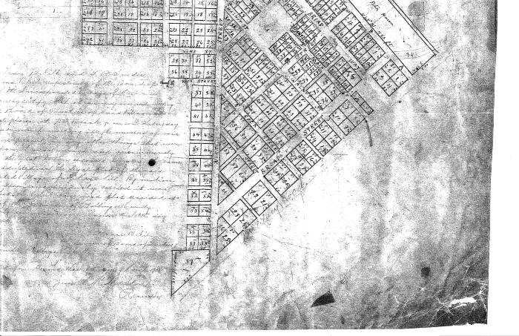
1906 Marble Hill City Plat Map (BCL-TOT-B-00003)
Scan of 1906 map of Marble Hill showing the military road, once part of the Benge route, running along the bottom edge of the town. It is faintly marked.

Slide 7
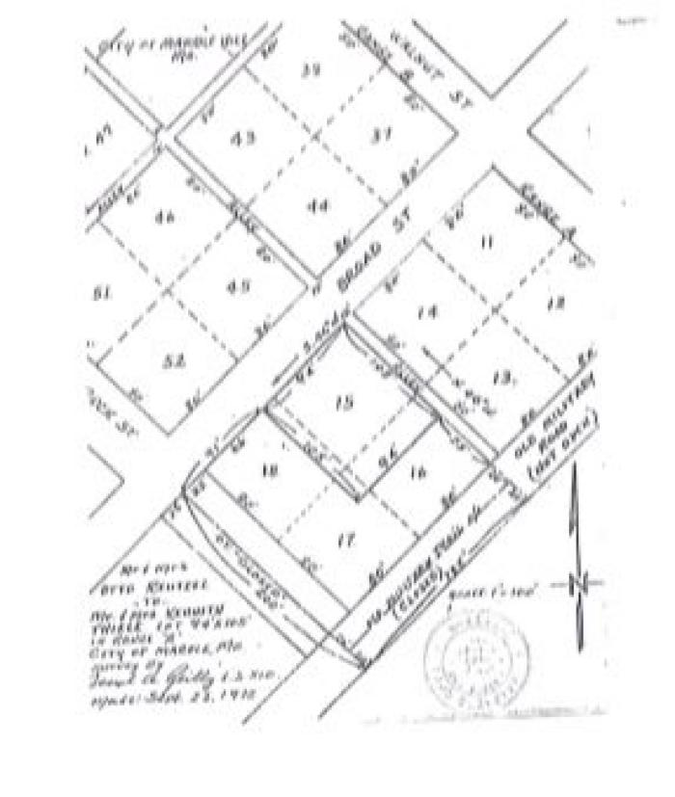
Marble Hill Reilly Survey (BCL-TOT-B-00004)
Joseph Reilly Survey map of Marble hill showing the old military road as it ran along the southern edge of the town center.

Slide 8
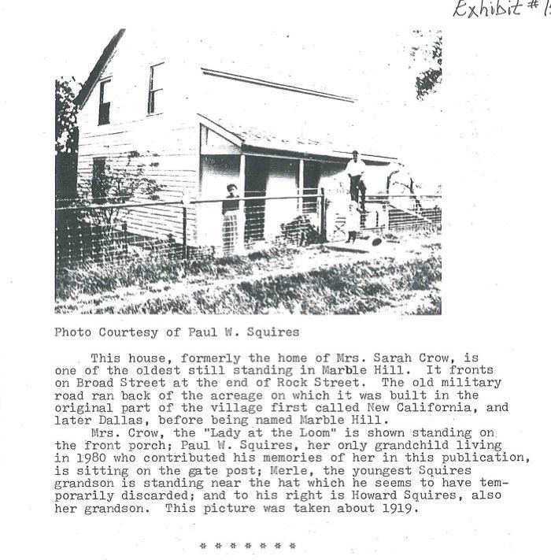
Crow House (BCL-TOT-B-00005)
Scan of photograph and caption showing the Crow house, formerly owned by Mrs. Sarah Crow, pictured here with her grandsons Paul and Howard Squires. This house was one of the oldest structures still standing in Marble Hill on Broad street and Rock street, and it the old military road (Benge route) would have run nearby this property.

Slide 9
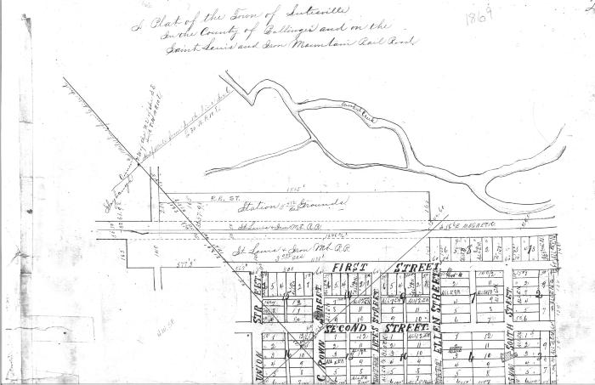
Section of 1869 Lutesville Plat Map (BCL-TOT-B-00006)

Slide 10
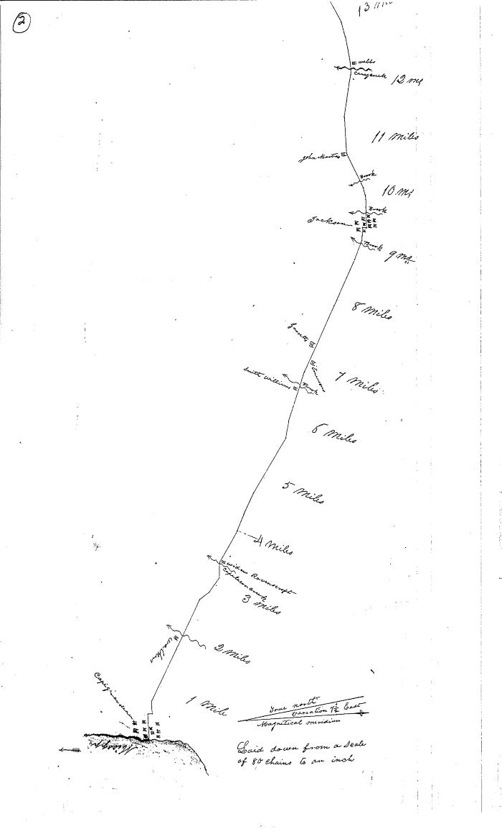
1837 Snider Survey of HWY 34 (BCL-TOT-B-00007)
Scanned section of the 1837 Snider Survey of HWY 34 (from Cape Girardeau to Arkansas) showing the Lutes property and the Crooked Creek crossing between miles 28 and 29. Hwy 34 is what most of the path the Benge route in this region was understood to follow

Slide 11
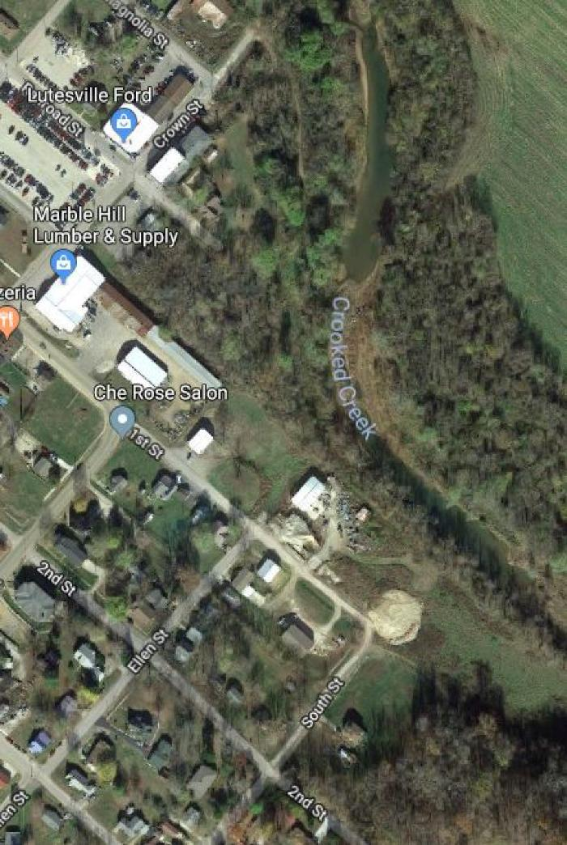
Crooked Creek Ford (BCL-TOT-B-00008)
Satellite image of aerial view of modern day Marble Hill showing the ford in Crooked Creek used in 1838 (and the Lutes house in the same location as recorded in 1837 state survey.)

Slide 12
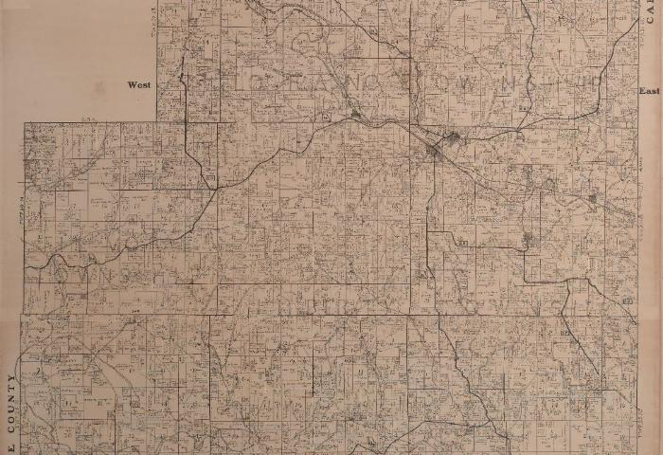
Section of 1906 Bollinger County Plat Map (BCL-TOT-B-00009)
;;Middle section of the Bollinger County plat map from 1906 showing how HWY 34 ran in 1906, going all the way to the county line.

Slide 13
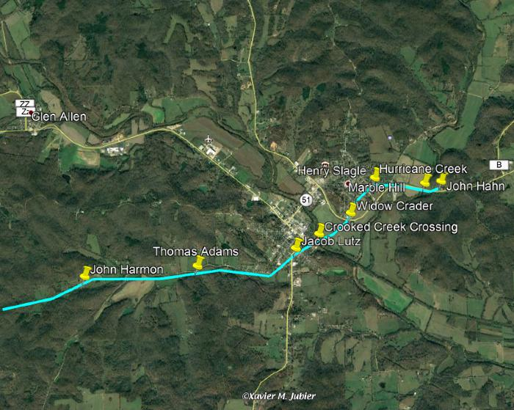
Benge Route Through Marble Hill (BCL-TOT-B-00010)
Present-day Marble Hill map with Benge route marked in green by MoDot historian Rusty Weisman. Shows the Crooked Creek crossing and indicates the locations of the earliest pioneer settlers' properties along the route.

Slide 14
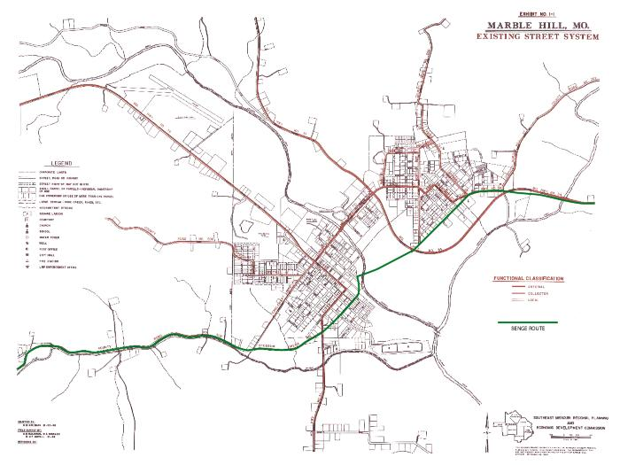
Marble Hill Street Map with Benge Route (BCL-TOT-B-00011)
Benge route marked in green on a modern street map of Marble Hill.

Slide 15
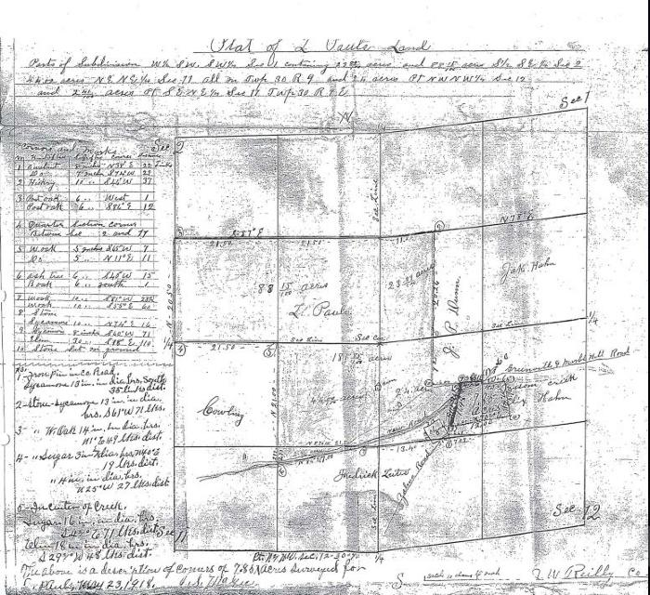
Section of 1918 J. W. Reilly Survey (BCL-TOT-B-00012)
1918 survey by J. W. Reilly showing an altered BCR 502 route one mile outside Marble Hill where 502 meets 519. Only document that shows this alteration to the road.

Slide 16
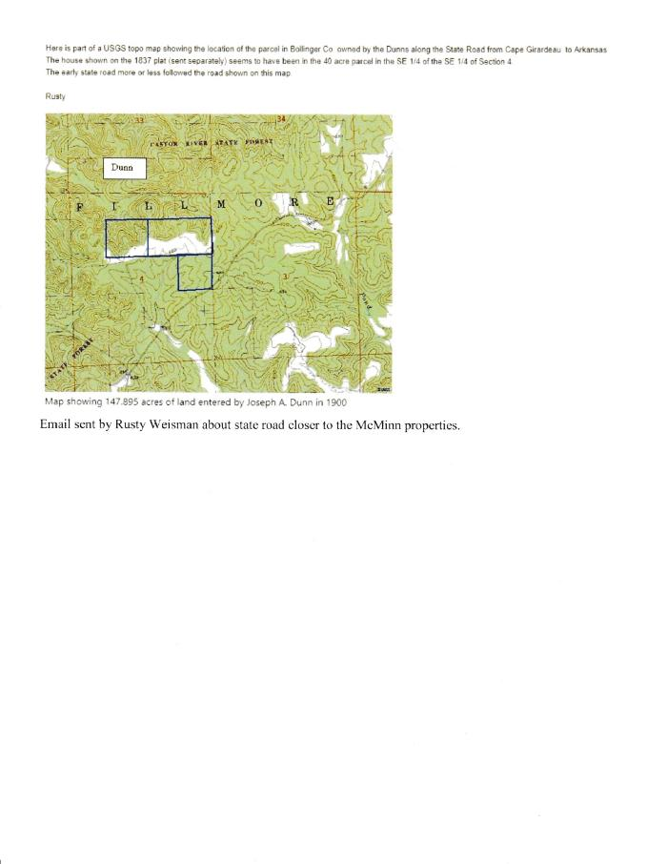
Email with 1900 Dunn Survey of McMinn Plat (BCL-TOT-B-00013)
;;Image of email sent by Rusty Weisman about the state road being closer to the McMinn properties with an image of, as listed in email: "Map showing 147.895 acres of land entered by Joseph A. Dunn in 1900."

Slide 17
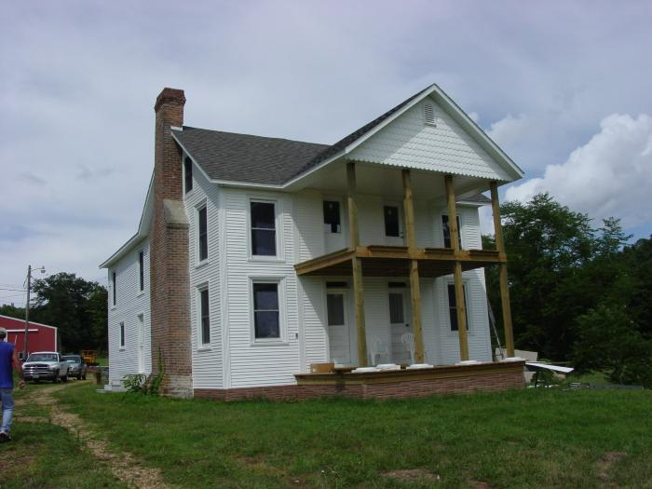
Restored McMinn House (BCL-TOT-B-00014)
;;Photographs of the exterior and interior of the McMinn house taken during its restoration in 1994. HWY 34 Greenville to Jackson road, part of the Benge route, ran between the McMinn house and the Buchana School. The McMinn house was a witness structure to the Benge trail. The fireplace shows the age of the structure, which was once a log structure. ( Photos by J.W. Layton)

Slide 18
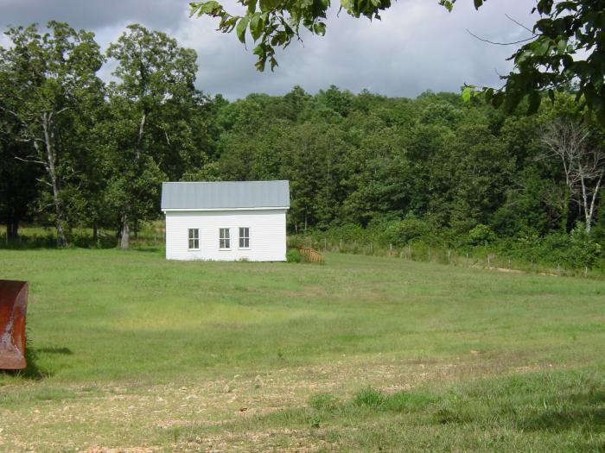
Restored Buchana School (BCL-TOT-B-00015)
;;Photograph of the Buchana School taken in 1994 after restorations. HWY 34 Greenville to Jackson road, part of the Benge route, ran between the McMinn house and the Buchana School. (Photo by J.W. Layton)

Slide 19
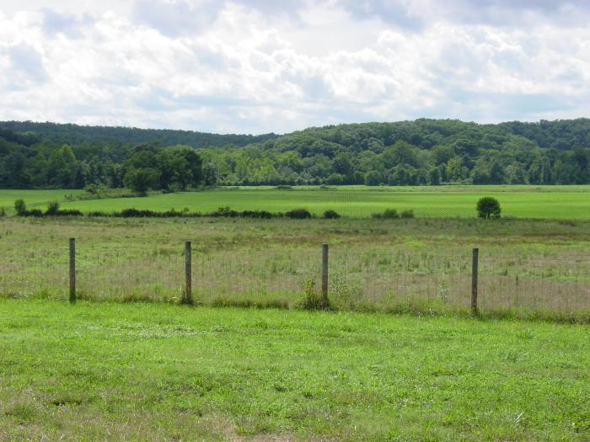
Views of the Castor River Valley from the McMinn Property (BCL-TOT-B-00016)
Photographs from the McMinn property looking out West at the Castor River Valley. The Military Trail (Benge Route) cut across the plantation and forded the Castor River into Wayne County where it crossed the Barnhart property. (Photos by J.W. Layton)

Slide 20
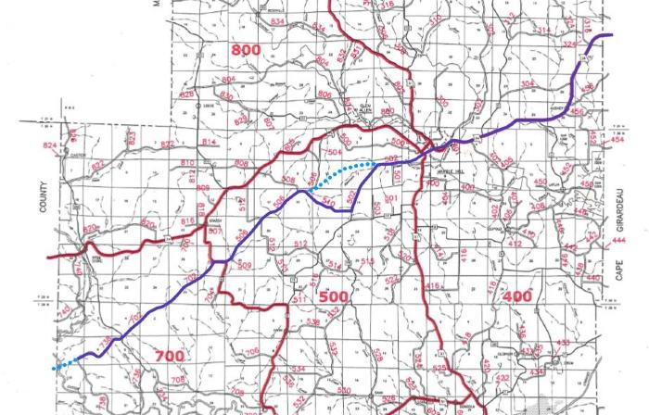
Bollinger County Map with Benge Route (BCL-TOT-B-00017)
;;The Benge route marked on current county map in purple. The blue dots are original segments of the trail that have since been vacated by the county.

Slide 21
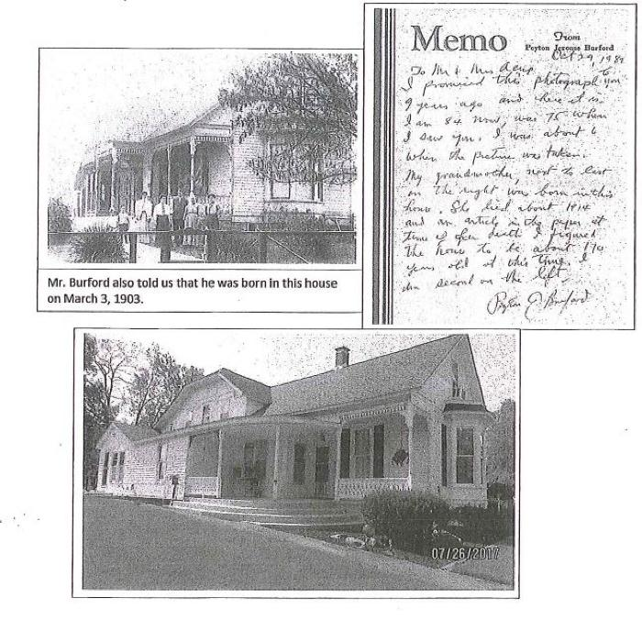
Documentation of Lutes/Acup House (BCL-TOT-B-00018)
;;This is a collection of scans including: a photograph of the Lutes house from 1911, a Memo from Peyton Burford written in Oct. 29, 1989 about the contents of the photo, and another image of the current Lutes/Acup house taken on July 26, 2017. The Lutes house was a witness structure to the Trail of Tears, located along the Benge Route as it passed through Marble Hill, MO.

Slide 22
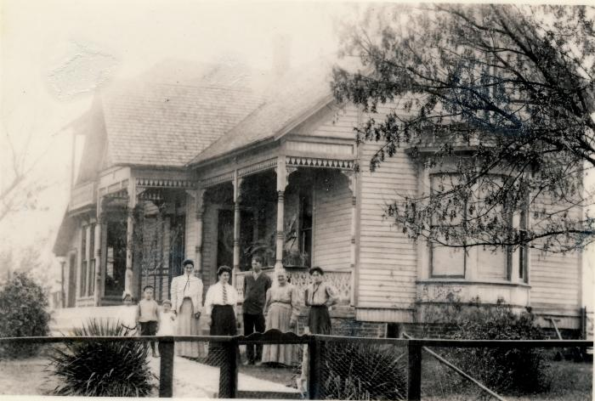
1903 Lutes House (BCL-TOT-B-00019)
;;Photograph of the original Lutes house, a witness structure on Benge route. Attached was a note from Mr. Peyton Burford that stated that the two story log structure under a portion of this house was about 170 years old in 1987. This would mean the original building date backs to 1817. Additions were added, and the house is now owned by Bill and Louise Acup.

Slide 23
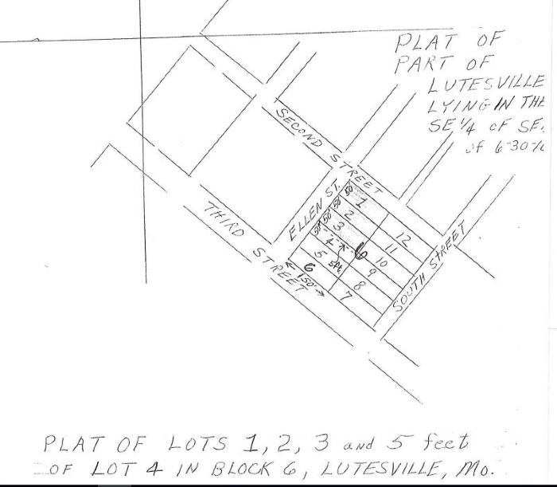
1837 Lutes House Location (BCL-TOT-B-00020)
;;The location of the Lutes house is shown on this section of the 1837 plat map of Lutesville (Marble Hill). The Lutes house was a witness structure to the Trail of Tears, as it was located along the Benge Route that passed through Marble Hill.

Slide 24
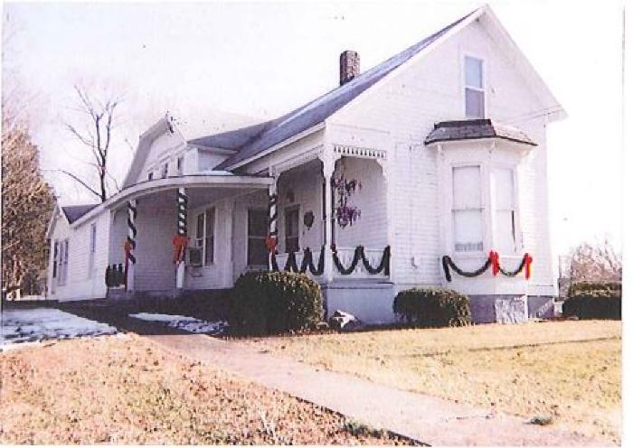
Lutes-Acup House (BCL-TOT-B-00021)
;;his is an image of the Lutes-Acup house as it appears now. The First Lutes house of 1817 is a log cabin hiding under a beautiful layer of siding and additions on Ellen St. in Marble Hill. This was a witness structure of the Trail of Tears on the Benge Route.

Slide 25
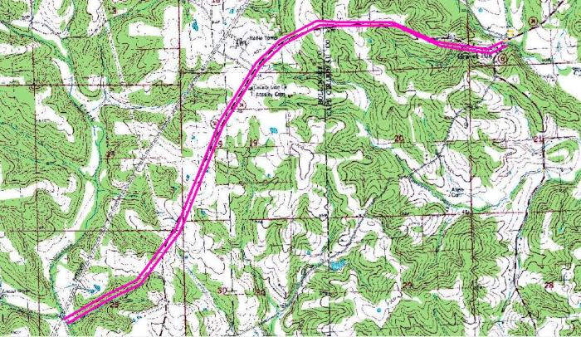
Benge Route Topographic Map (BCL-TOT-B-00022)
;;his is the Benge Route from Gravel Hill following the 1837 survey.

Slide 26
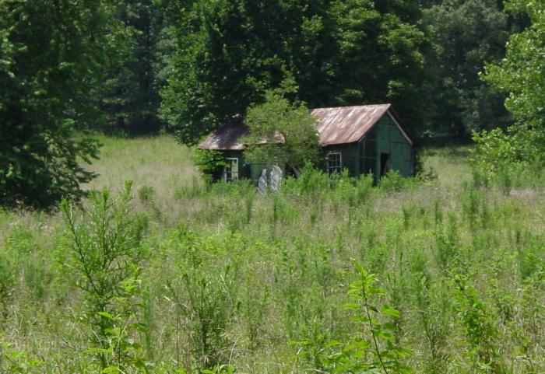
North Side of Old Possum Creek Road (BCL-TOT-B-00023)
;;Photos of a portion of the Benge Route on Possum Creek Road, which has been vacated.

Slide 27
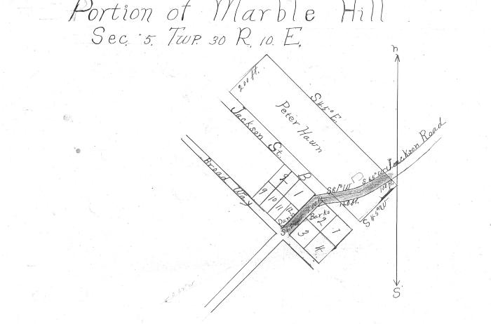
1922 Marble Hill Survey, Jackson Road (BCL-TOT-B-00024)
;;Survey of a portion of Marble Hill (Sec. 5 Twp 30 R 10 E) done in Dec. 1922 to, as the inscription reads, "establish a connecting street between Broadway and beginning of Jackson Road at corporate limits and to change Broadway at Lot No. 2 Ra and Lot no. 12 R.B. as indicated on Plat." The survey is signed by J.S. McGee. This shows the postal/military road (State Road 34) used as part of the Benge route previously.

Slide 28
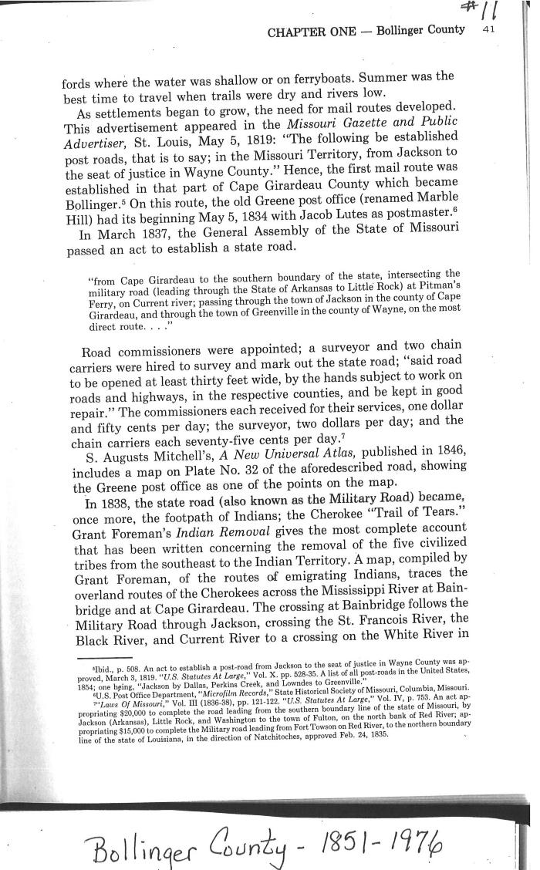
Postal Road 34 History (BCL-TOT-B-00025)
;;This excerpt from Bollinger County: 1851-1976 describes the history of the first mail route established from Jackson to Wayne County which later became the Military Road transversed by the Cherokee as part of the Benge route. The state road was established in 1837, and in 1838, it was part of the Trail of Tears.

Slide 29
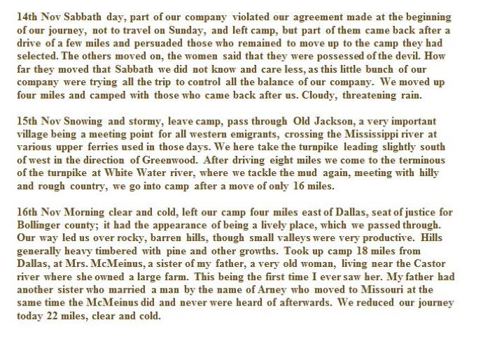
Darr Journal Entries through Bollinger County (BCL-TOT-B-00026)
;;Transcription of journal entries from the Darr Journal detailing their trip across the Benge trail 20 years after BB Cannon's journey. Describes sites such as Old Jackson, Whitewater river, and (now named) Marble Hill were described in the entries on Nov. 14-16th.

Slide 30
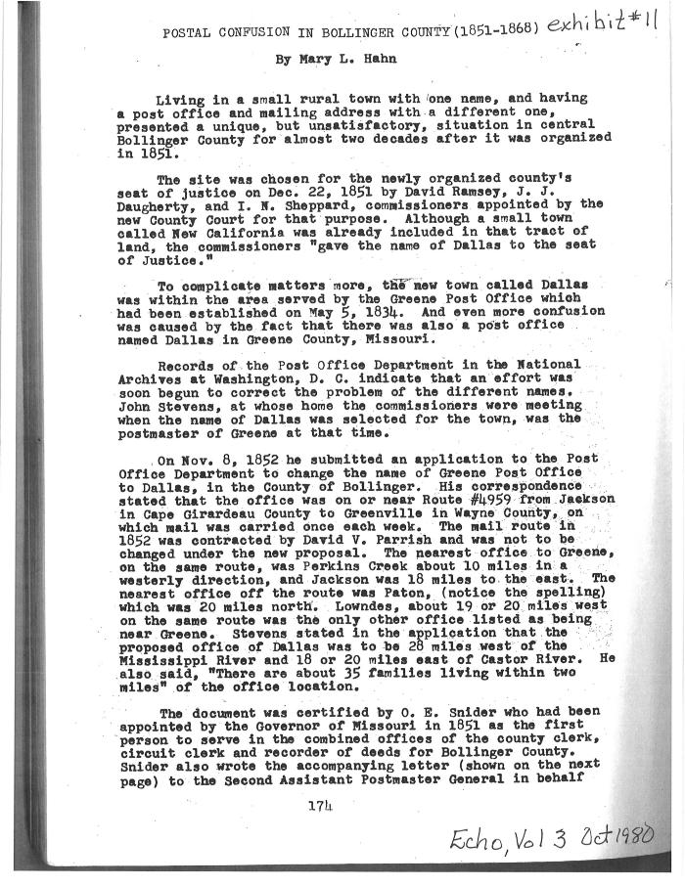
Hahn's Description of Greene Post Office (BCL-TOT-B-00027)
;;This document, titled "Postal Confusion in Bollinger County (1851-1868)", is an account by Mary L. Hahn of the renaming and building of a new post office in Bollinger County. The old post office's location is described to be "on or near Route #4959 from Jackson in Cape Girardeau County to Greenville in Wayne County", and this original building would've been a witness structure to the military/postal road that was part of the Trail of Tears Benge route. This establishes the presence of the Lutes family in the region, prior to the trial.

Slide 31
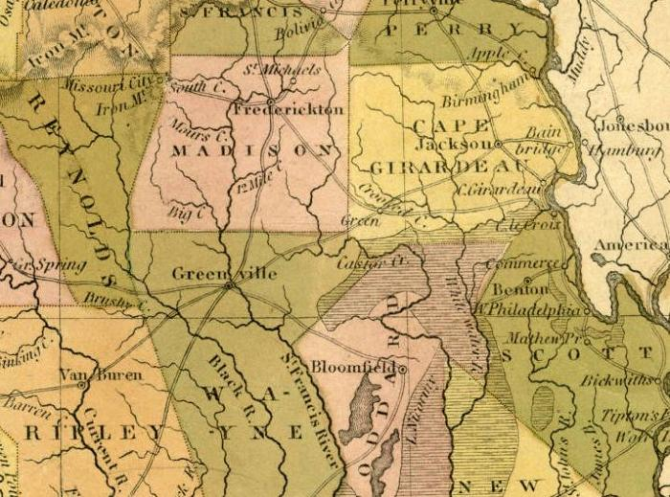
Section of Burr Postal Map (Pre-Bollinger County Map) (BCL-TOT-B-00028)
;;Section of 1834 Missouri map showing Wayne, Cape Girardeau, Stoddard counties (parts of which would later form Bollinger County) and Madison. The historic towns of Frederickton, Jackson, and Greenville. Greene is marked (listed "Green") on the route from Jackson to Greenville on this map; this is where present-day Marble Hill is located.

Slide 32
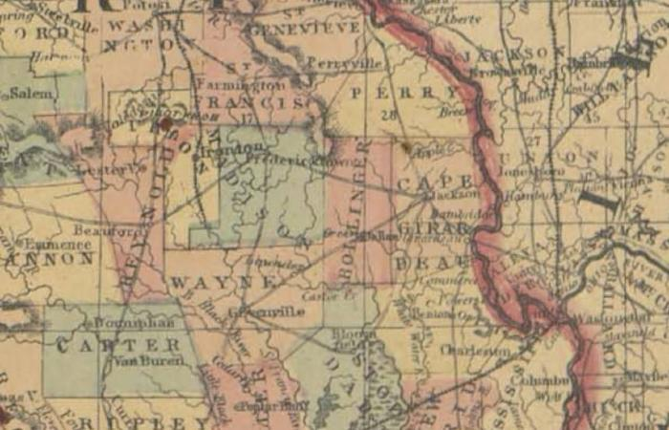
Section of 1864 Burr Postal Map (BCL-TOT-B-00029)
;;Section of 1864 Missouri map showing Bollinger County between Wayne, Cape Girardeau, Madison counties. The historic towns of Frederickton, Jackson, and Greenville. Green is marked on the route from Jackson to Greenville on this map, which is where present-day Marble Hill is located.

Slide 33
Lutesville Dollar Store and Flour Mill (BCL-TOT-B-00030)
;;This excerpt from Johannes Georg Lutz: 1706-1756 And His Descendants describes the location of the Dollar Store on Main Street and the flour mill run by Jacob Lutes in the first half of the nineteenth century. These would have been sites present when the Benge Route was used, passing through Lutesville (now called Marble Hill).

Slide 34
History of Bollinger County and Marble Hill (BCL-TOT-B-00031)
;;This 2 page excerpt from the History of Southeast Missouri briefly describes the legal founding of Bollinger County and the County seat, presently called Marble Hill. This document is important as is notes where the town originally began, much farther East that present-day Marble Hill.

Slide 35
Court Record of Marble Hill's Renaming (BCL-TOT-B-00032)
;;Court records of the petition and official filing to rename the plat of land called Dallas to Marble Hill.

Slide 36
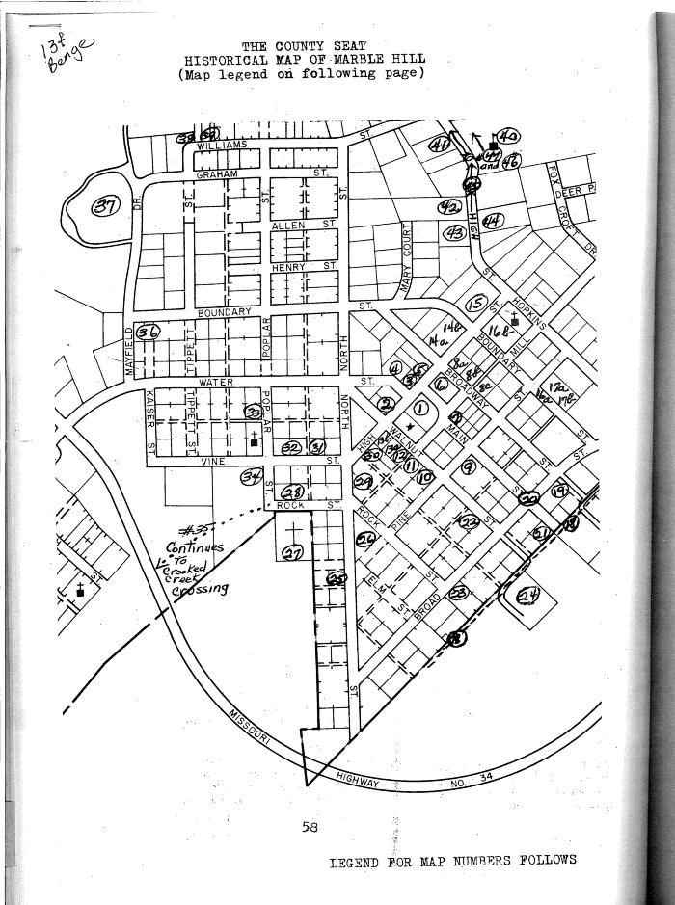
The County Seat Historical Map of Marble Hill (BCL-TOT-B-00033)
;;This is a map of the town of Marble Hill showing important historical sites indicated by numbers. Of particular significance to the Trail of Tears is #18 the Old Military Trail (Benge Route) and the sites along it built prior to 1839.

Slide 37
County Records of Lutes Family Property (BCL-TOT-B-00034)
;;An inventory and application for the Letters of Administration of the the late King estate made by Eli Lutes, the administrator of the estate, on March 7th, 1912. A Bollinger county probate court record describing affairs of the Lutes estate as of May 18, 1866. These are important to tracing ownership of the Lutes house, a witness structure to the Benge trail.

Slide 38
Marble Hill Plat Map with First Landowners (BCL-TOT-B-00035)
;;Scan of a modern-day Marble Hill plat map with markings added to show the land owned by Jacob Lutes and first settlers in the region.

Slide 39
List of Land from Tax Book of Bollinger County (BCL-TOT-B-00036)
;;Eli Lutes and his property is listed on page 97 under #3026 in the Tax Book of Bollinger County. The Lutes property was part of the land the Benge route passed through.

Slide 40
Copy of Bollinger County Land Entry Book (BCL-TOT-B-00037)
;;Bollinger County plat map showing the Lutesville/Marble Hill region, featuring the land owned by Jacob Lutes and the first families. The Benge route passed through this region, and the Lutes house was a witness structure on the Lutes property.

Slide 41
Original Land Patents of Bollinger County, MO (BCL-TOT-B-00038)
;;A list of names and associated plats of the people that first filed on the land from the Lutesville/Marble Hill region, listed as Township 30N Range 8E. Features Jacob Lutes 1849-1859.

Slide 42
Echo, Vol. 4 Historic Sites Marble Hill (BCL-TOT-B-00039)
;;These excerpts from the journal Echo feature a map of the "Plat of the Town of New California" (present-day Marble Hill), a description of the first courthouse, and a description of the "old southern trail" which was part of the Benge route.

Slide 43
Excerpt from "Bits of History" (BCL-TOT-B-00040)
;;This excerpt from Hahn's Bits of History describes the early history and first white settlers of Bollinger County, specifically the Lutesville region. John Lorance, Col. Bollinger, and Eli Deck are recorded as the first pioneers to settle in Lutesville and Glen Allen, Daniel Hahn settled at Possum Creek (then Hahn Creek). Later the Benge route of the Trail of Tears would pass through these settlers' properties. A photograph of a 1957 plaque commemorating the the founding history of Marble Hill and photos of the road between Lutesville and Marble Hill and the Swinging Bridge are also featured.

Slide 44
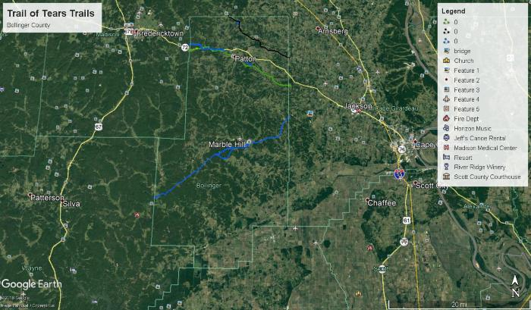
Trail of Tears Routes through Marble Hill (BCL-TOT-B-00041)
;;Satellite map image of Marble Hill with a blue line indicating the Benge route.

Slide 45
Bollinger County Trail of Tears Map (BCL-TOT-B-00042)
;;Map of the Bollinger County Trail of Tears Routes, showing the Northern (black), Hildebrand (green), and Benge (blue) routes and vacated trails (blue dots) as they passed through the region.

Slide 46
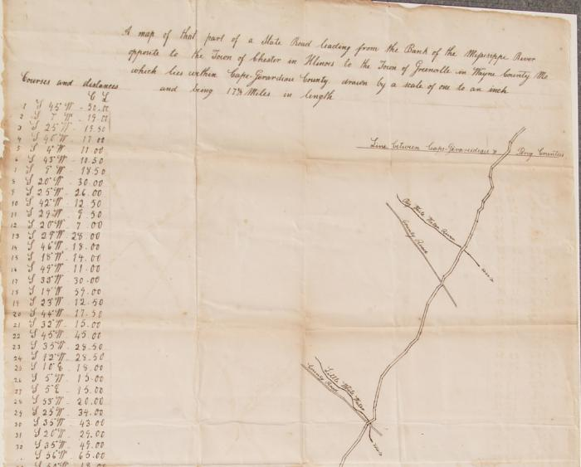
Snider Road Survey (BCL-TOT-H-00001)
;;1843 State Road Survey by Aaron Snider showing portion of Jackson to Fredericktown Road, listed on this map as "County Road.

Slide 47
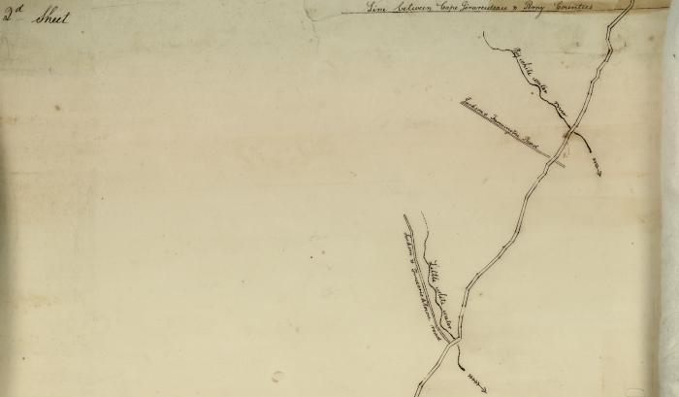
1843 State Road Survey (BCL-TOT-H-00002)
;;1843 State Road map with inscribed map description and illustration of the road as it runs from the Mississippi River to Greeneville in Wayne County, featuring a where the state road crossed the Jackson to Fredericktown Road, listed as such.

Slide 48
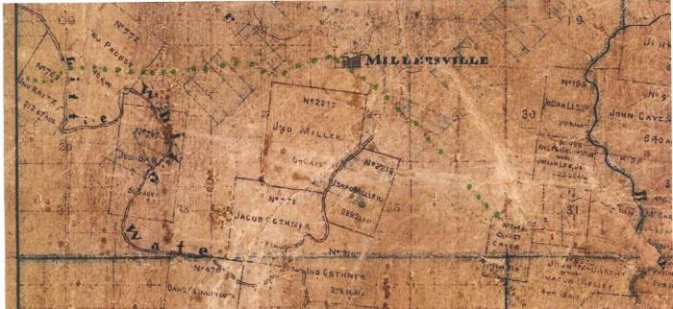
1870 Brooks Cape County Map (BCL-TOT-H-00003)
;;James Brooks Cape County map from 1870 which faintly shows the Jackson to Fredericktown road coming from Millersville to the edge of Cape County, a part of the Hildebrand trail.

Slide 49
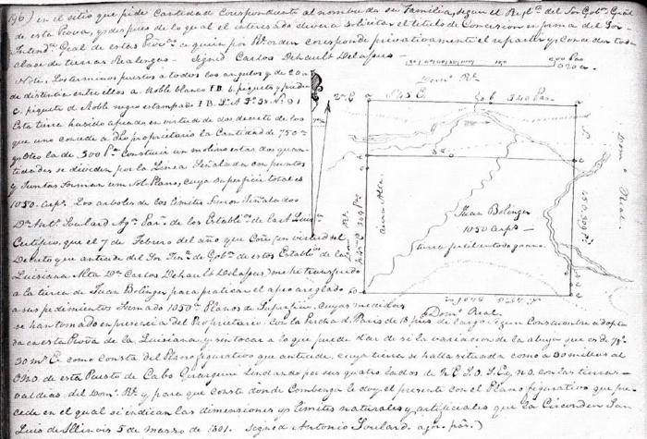
1801 Riley Patton Survey (BCL-TOT-H-00004)
;;Patton Survey No. 768 done by surveyor Riley showing Jackson to Fredericktown road as it passed through John Bollinger's land.

Slide 50
1812 Commissioner's Certificated Land Grants (BCL-TOT-H-00005)
;;A list of Commissioner Certificates showing the grant of Survey No. 768 to John Bollinger, the plot of land which the Jackson to Fredericktown road (section of the Hildebrand trail) ran through.

Slide 51
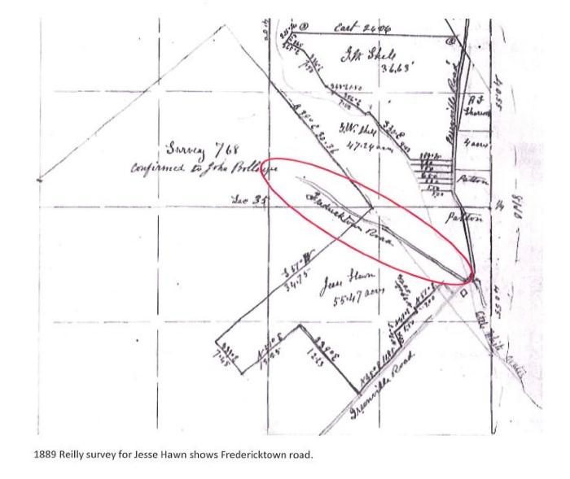
1889 Reilly Survey (BCL-TOT-H-00006)
;;Section of1889 Reilly survey for Jesse Hawn which shows the Fredericktown road, part of the Hildebrand route.

Slide 52
Township 33N Range 8E Map (Pre-HWY61) (BCL-TOT-H-00007)
;;Scan of damaged map of Township 33N Range 8E, drawn before HWY 61/72 was mapped. Shows the exit from Bollinger County into Madison County, just south of Cape Creek, that would meet MCR 248 toward Castor Station then Fredericktown.

Slide 53
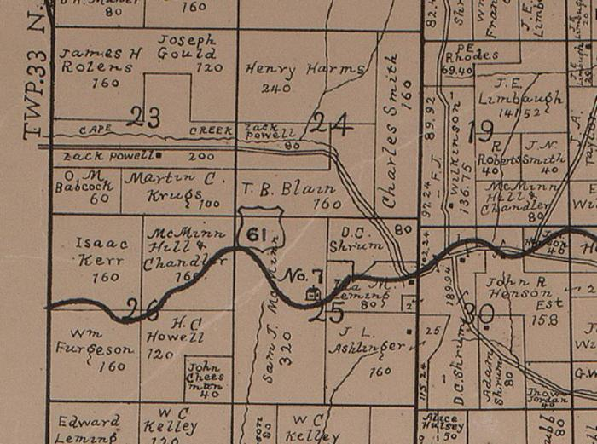
1906 Township 33N Range 8E Map (BCL-TOT-H-00008)
;;1906 map of Township 33N Range 8E showing HWY 61 exit from Bollinger County into Madison County, just south of Cape Creek, that would meet MCR 248 toward Castor Station then Fredericktown.

Slide 54
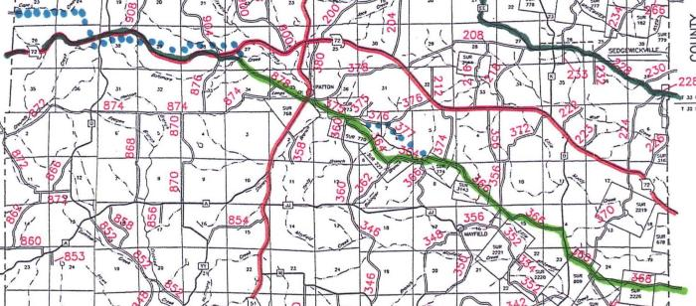
2018 Road Map with Hildebrand Route (BCL-TOT-H-00009)
;;Modern map showing the Hildebrand route indicated in green and blue dots marking where researchers believe the road originally was but was vacated or moved by the county.

Slide 55
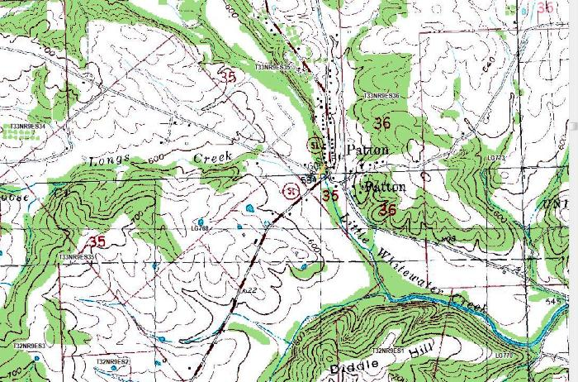
2018 Patton Map (BCL-TOT-H-00010)
;;Section of map showing modern day Patton area. Crossing HWY 51 onto Bollinger County Road 878. BCR 878 has been vacated along the portion that connected to present day HWY 72 to where it crossed into Madison County just south of Cape Creek. This is the route believed to be along the Hildebrand trail.

Slide 56
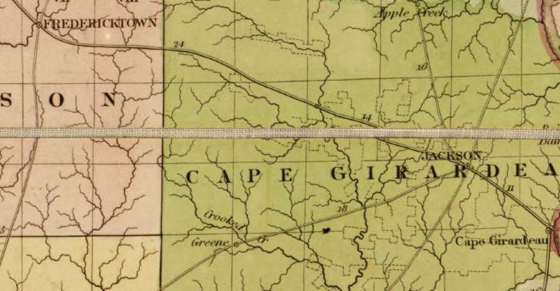
1839 Burr Post Roads Map (BCL-TOT-H-00011)
;;Section of 1839 David H. Burr Post Roads map showing Jackson to Fredericktown road.

Slide 57
Echo Vol. 2 (October 1979) (BCL-TOT-H-00012)
;;This 1979 publication of Echo by the Bollinger County Historical Society is filled with literature and photographs that describe the nineteenth-century properties and people that would have resided near/along the Hildebrand and Northern routes that passed through Bollinger County. This information provides local historical context for these trails and connects to the other documents and maps in this collection.

Slide 58
Excerpts from "I Remember the Ozarks" (BCL-TOT-H-00013)
;;Excerpts from the book I Remember the Ozarks by Charles H. Williams include Williams's account of his grandfather's (William Williams) farm as it was situated near Mayfield Creek down to Little Whitewater Creek. His father was the Bollinger County Surveyor. A survey map of the Mayfield region is included, and a map of the Patton to Mayfield roads is also featured.

Slide 59
Bollinger County Trail of Tears Map (BCL-TOT-H-00014)
;;Map of the Bollinger County Trail of Tears Routes, showing the Northern (black), Hildebrand (green), and Benge (blue) routes and vacated trails (blue dots) as they passed through the region.

Slide 60
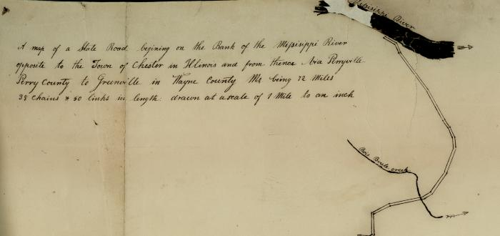
1843 State Road Map (BCL-TOT-N-00001)
;;1843 State Road map with inscribed map description and portion of state road from the Mississippi river through the county line, showing portion of Jackson to Fredericktown Road, listed as such, as it crosses the state road.

Slide 61
1843 Snider Road Survey (BCL-TOT-N-00002)
;;1843 State Road Survey by Aaron Snider showing portion of Jackson to Fredericktown Road, listed on this map as County Road.

Slide 62
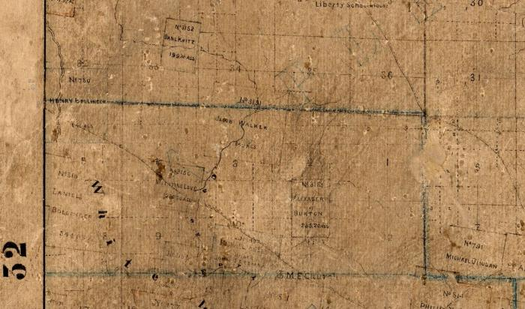
1870 Brooks Cape County Map (BCL-TOT-N-00003)
;;James Brooks Cape County map from 1870 which faintly shows the Jackson to Fredericktown road coming from Millersville to the edge of Cape County, a part of the Northern trail.

Slide 63
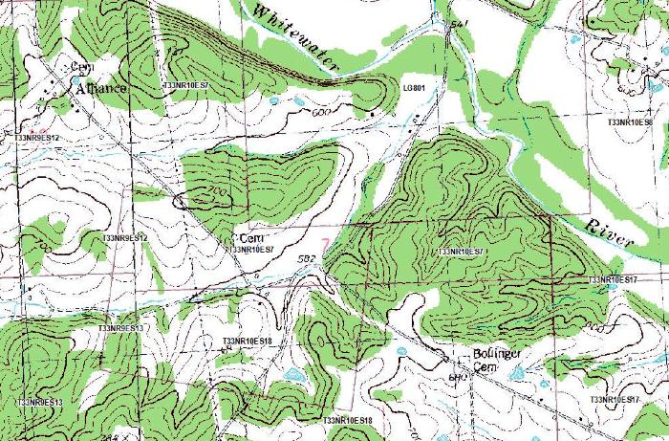
US Survey 3145 (BCL-TOT-N-00004)
;;Modern topographical map of US Survey 3145 (Township 33 North) showing the modern road that partially follows the same route as the Northern trail.

Slide 64
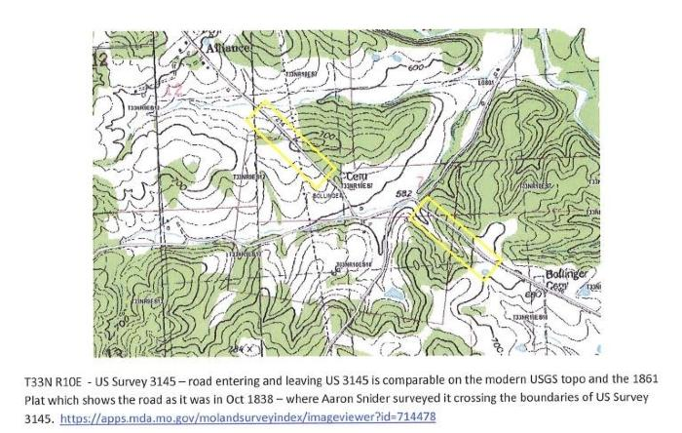
Northern Route on US Survey 3145 (BCL-TOT-N-00005)
;;Marked section of modern topographical map of US Survey 3145 (Township 33 North) showing the modern road that partially follows the same route as the Northern trail. Yellow boxes indicate the sections of the road that line up with the 1838 road, as part of the Northern trail.

Slide 65
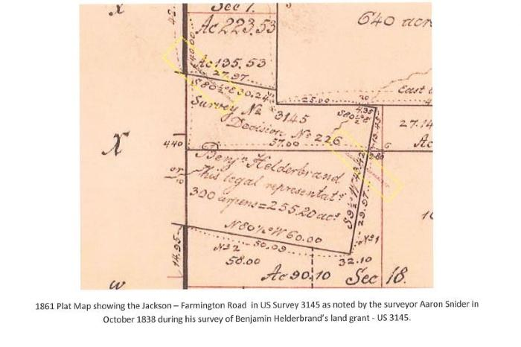
1861 Plat Map with Jackson to Farmington Road (BCL-TOT-N-00006)
;;1861 Plat Map showing the Jackson to Farmington Road in US Survey 3145; Marked 1861 Plat Map showing the Jackson to Farmington Road in US Survey 3145. Yellow boxes indicate the location of the Farmington Jackson road on this map, as it was part of the Northern route.

Slide 66
US Survey 3145 Notes by Benjamin Helderbrand (BCL-TOT-N-00007)
;;Marked section of survey notes of Benjamin Helderbrand's Decision No. 226 pertaining to US Survey 3145. The red box indicates where the Jackson to Farmington road is mentioned in the document.

Slide 67
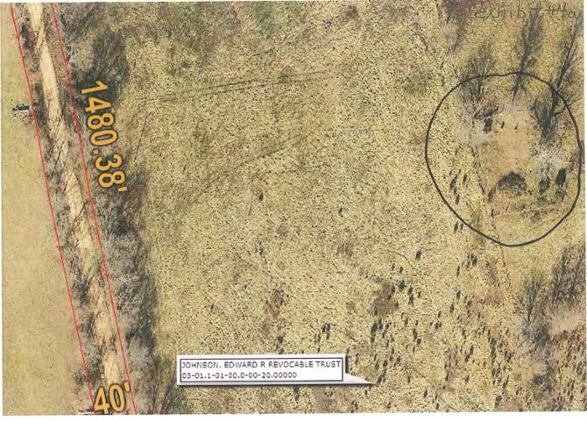
Conrad Johnson Cemetery (BCL-TOT-N-00008)
;;This digital satellite image shows an aerial view of the Conrad Johnson Cemetery along BCR 214, established in the 1830s, would have been along the route of the Northern trail. The trail continued west on BCR 246 and then onto BCR 214, passing the Conrad Johnson Cemetery shown.

Slide 68
German Reformed Church (BCL-TOT-N-00009)
;;This illustration represents the mill turned German Reformed Church that would've been along the Northern route. This mill/church was located along current day BCR 930.; Booklet German Reformed Church 1805-1832, Fadler Documents

Slide 69
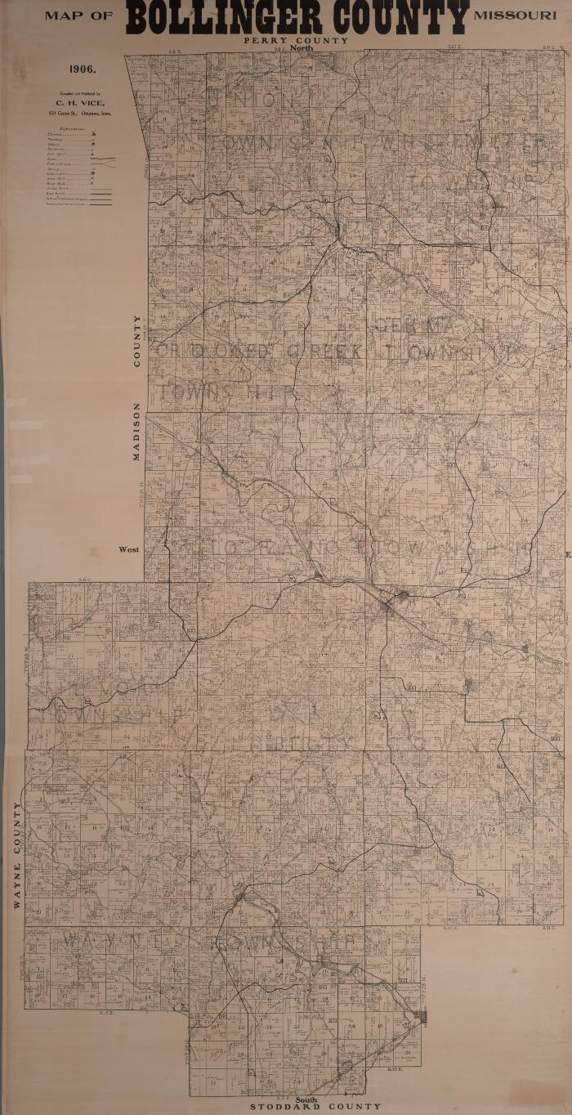
1906 Bollinger County Plat Map (BCL-TOT-N-00010)
;;Plat map of Bollinger County, showing BCR 214 and BCR 930 and locations along the Northern route, including the Hahn mill. This map shows an important difference between present day BCR 214 and 930, as the road follows through land grant families' plats and varies slightly from the modern road.

Slide 70
1906 Hahn Mill Location (BCL-TOT-N-00011)
;;Section of 1906 Bollinger County Map that shows the Hahn mill and spring site. The Hahn site was a resting place for the Cannon party in 1837.

Slide 71
2020 Hahn Mill Location (BCL-TOT-N-00012)
;;This digital satellite image shows an aerial view of the modern day location where the remains of the Hahn mill are located.

Slide 72
Present Day Remains of Hahn Mill (BCL-TOT-N-00013)
;;Photographs of the remains from the Hahn mill race and dam. The Hahn site was a resting place for the Cannon party on Nov. 17, 1837.; Photographed by Eva Dunn

Slide 73
Present Road Map with Northern Route (BCL-TOT-N-00014)
;;Present day map with Northern route marked in green. The blue dots are where researchers believe the original road and Northern route was located. It was possibly later vacated by the county and the road now runs along the present route.

Slide 74
Dolle-Bollinger Mill (BCL-TOT-N-00015)
;;Drawing of the Dolle/Bollinger mill as it appeared in the 1980s. The mill was originally built in 1828 and would have been a witness structure to the Trail of Tears as it was located along the Northern route.

Slide 75
1870 Jackson on Brooks Cape County Map (BCL-TOT-N-00016)
;;Scanned section of the 1870 James Brooks Cape County map showing the Jackson area, as the Jackson to Farmington road would've followed a portion of the Northern route.

Slide 76
1832 Whitewater Presbyterian Church Congregation (BCL-TOT-N-00017)
;;This photograph shows the charter members of the Whitewater Presbyterian Church that was established in 1832. These pioneer families were witnesses to the Cherokee removal as the detachments passed by their homesteads on the Northern route through Sedgewickville.

Slide 77
Plat Map of Bollinger County Pioneer Families (BCL-TOT-N-00018)
;;Plat map that lists land owned by early pioneer families of the Bollinger County area.

Slide 78
Missouri Indian Trails (BCL-TOT-N-00019)
;;Mo. Surveyor, Cyrus McCormick interviewed Hahn family for knowledge of Native American Trail of Tears camp at Hahn Mill.

Slide 79
Bollinger County Trail of Tears Routes (BCL-TOT-N-00020)
;;Map of the Bollinger County Trail of Tears Routes, showing the Northern (black), Hildebrand (green), and Benge (blue) routes and vacated trails (blue dots) as they passed through the region.

Slide 80
Draft of Bollinger County Trail of Tears National Historic Trail (BCL-TOT-N-00021)
;;Draft of the National Parks Service's Trail of Tears National Historic Trail, showing maps of the Northern route through the area and reports of funding and sign-postings.

Slide 81
Conrads 1750 -1886 (BCL-TOT-N-00022)
;;This brief biography of David Rudolph Conrad describes his membership in the Whitewater Presbyterian church which met in a witness structure to the Northern trail. It also describes his purchase of the US Survey #801.

Slide 82
From Seebach to Seabaugh: 1123-1988 (BCL-TOT-N-00023)
;;A family biography featuring Christian Seabaugh, early pioneer of Bollinger County region.; From Seebach to Seabaugh: 1123-1988 by Otto Seabaugh; Publisher: Jackson, Mo, 1988, pg. 94-96, 107-108.

Slide 83
Map of Northeast Bollinger County Historic Sites Tour (BCL-TOT-N-00024)
;;Bollinger County map that documents major roads, creeks, and towns. Important landmarks are itemized in Echo book.; Echo Vol. 2 (October 1979)

Slide 84
Bollinger County Map Historical Sites (BCL-TOT-N-00025)
;;Bollinger County map that documents important historical landmarks, including the Whitewater Church and Bollinger-Dolle Mill that were witness structures to the Northern trail.

Slide 85
Township 32N Map (BCL-TOT-N-00026)
;;"Map of Township 32 North of the base line Range 9 East of the 5th principal Meridian," showing John and Frederick Bollinger land ownership in the region.

Slide 86
Bollinger-Dolle Mill Article (BCL-TOT-N-00027)
;;This article describing the history of Sedgewickville, details the history of the Bollinger-Dolle Mill, which was a witness structure to the Northern route on the Trail of Tears. This article also features two photos of the mill as it stood in 1992. Today, the mill is in very fragile condition.; "Goodbye Smithville, Hello Sedgewickville." In Southeast Missourian, April 19, 1992 issue, Section C. by B. Ray Owen (Photos by Fred Lynch)

Slide 87
Township 33N Range 10E Map (BCL-TOT-N-00028)
;; Present day plat map that shows current owners of Hahn property, first mill site of Fadler mill and Northern route that changed very little from county roads of today.

Slide 88
Transcribed Excerpts from BB Cannon Diary (BCL-TOT-N-00029)
;;Transcriptions of entries from the journal of B.B. Cannon, the conductor of a removal party of Cherokee Natives in the year 1837, describes their stops in Bollinger County, as they passed through the region on the Northern Trail. Entry from Nov. 16th describes their use of the Jackson-Fredericktown road. The Nov. 17th entry details their stop at White Water creek, probably at the Hahn Mill formerly located there.

Slide 89
Family History of the Bollinger Mill (BCL-TOT-N-00030)
;;A family history submitted by Carol Bollinger, who describes the history of the Bollinger-Dolle mill, a witness structure on the Northern route.; "History of the Matthias Bollinger Family and Bollinger Mill, Submitted by Carol Bollinger," From Bollinger County Family History Collection, pg. 3-4.

Slide 90
Hopewell Cemetery Register with Bollinger and Dolle Family Members (BCL-TOT-N-00031)
;;This documentation of those buried at the Hopewell Cemetery confirms Carol Bollinger's detailing of the location of Matthias Bollinger and his family's final resting place as recounted in the "Family History of the Bollinger Family and Bollinger Mill."

Slide 91
German Reformed Church History (BCL-TOT-N-00032)
;;Document detailing the history of the German Reformed Church that would've been along the Northern route, a witness structure to the trail of tears. This church later became an active mill.; Booklet German Reformed Church 1805-1832, Fadler Documents

Slide 92
German Reformed Church Location (BCL-TOT-N-00033)
;;Map showing the location of the German Reformed Church that would've been along the Northern route, a witness structure to the trail of tears. This church later became an active mill.; Booklet German Reformed Church 1805-1832, Fadler Documents

Slide 93
4 inch iron cannonball (bcmnh-historical-00001)
;;4 inch iron cannonball

Slide 94
Banner Press printing press (bcmnh-historical-00002)
;;Banner Press printing press used for flyers (not actual newspaper press)

Slide 95
Doc at the Press (bcmnh-historical-00003)
;;Framed Sketch of Lawrence "Doc" Hahn at the Banner Press Printing Press

Slide 96
Mirrored oak dresser (bcmnh-historical-00004)
;;Mirrored oak dresser circa 1930s from the Hahn Estate on loan from the Museum to the LIbrary

Slide 97
The cat's meow homemade wine (bcmnh-Runnels-00001)
;;Wine bottle received from Shrum family created by Tom Runnels approximately 40 years ago. Liquid contents intact with cork stopper.

Slide 98
Ozark Glory Yearbook 1928 (bcmnh-wmhf-ozglyearbook-00001)
;;1928 Ozark Glory Yearbook, documenting the 1928-29 school year at the Will Mayfield College.

Slide 99
Ozark Glory Yearbook 1929 (bcmnh-wmhf-ozglyearbook-00002)
;;1929 Ozark Glory Yearbook documenting the 1929-30 school year at the Will Mayfield College

Slide 100
Ozark Glory Yearbook 1927 (bcmnh-wmhf-ozglyearbook-00003)
;;Ozark Glory Yearbook 1927 physical item in the Museum

Slide 101
Ozark Glory Yearbook 1925 (bcmnh-wmhf-ozglyearbook-00004)
;;1925 Ozark Glory Yearbook from the Will Mayfield College

Slide 102
Ozark Glory 1920 (bcmnh-wmhf-ozglyearbook-00005)
;;Ozark Glory 1920 Published by: Senior Class of Will Mayfield College

Slide 103
Ozark Glory 1924 (bcmnh-wmhf-ozglyearbook-00006)
;;Ozark Glory 1924 Published by: Students of Will Mayfield College

Slide 104
Ozark Glory Yearbook 1919 (bcmnh-wmhf-ozglyearbook-00006)
;;Ozark Glory Yearbook - Will Mayfield College From the Press Of: The Sikeston Standard Sikeston, MO 63801

Slide 105
Will Mayfield College (bcmnh-wmhf-WMC1981)
;;Will Mayfield College aerial view 1981

Slide 106
Bridge over Hurricane Creek - Old Scopus Road 1981 (boco-bridges-001)
;;Bridge over Hurricane Creek - Old Scopus Road 1981

Slide 107
Millers Chapel (boco-churches001)
;;Miller Chapel - Glen Allen, MO Missionary Baptist 1895

Slide 108
First (1st) Baptist Church (boco-churches002)
;;First (1st) Baptist Church - Glen Allen Mo

Slide 109
Ladd Chapel - Genera Baptist Church (boco-churches003)
;;Ladd Chapel - Genera Baptist Church

Slide 110
Whitewater Presbyterian Church (boco-churches004)
;;Whitewater Presbyterian Church organized 6/24/1832 by Rev. James Sadd building erected 1842 North of Sedgewickville, MO

Slide 111
Bollinger County Library (boco-history002)
;;Bollinger County Library 302 Conrad Location

Slide 112
Bollinger County Library (302 Conrad Location) (boco-history003)
;;Bollinger County Library (302 Conrad Location)

Slide 113
Old Military Road (boco-militarytrail)
;;Old Military Road

Slide 114
Bollinger County Timber Industry (boco-timber001)
;;Bollinger County Timber Industry Stave mills in Patton and Lutesville

Slide 115
Bollinger County Mo Birth & Death Register 1883-1892 (bocobirth/deathreg1883-1892)
;;Bollinger County Mo Birth & Death Register 1883-1892

Slide 116
Bollinger County Census 1860 (BoCoCensus-1860)
;;Bollinger County Census 1860

Slide 117
Bollinger County Census 1900 (BoCoCensus-1900)
;;Bollinger County Census 1900

Slide 118
Bollinger County Census 1920 (BoCoCensus-1920)
;;Bollinger County Census 1920

Slide 119
Bollinger County Library 75th Anniversary Newspaper Article (bocolib-75thAnniv.)
;;Bollinger County Library 75th Anniversary Newspaper Article 06/29/22

Slide 120
Bollinger County CourthouseJames McBride (bocolib-art-001)
;;sketch - Bollinger County Courthouse By: James McBride; Bollinger County Library

Slide 121
Bollinger Dolle Mill (bocolib-art-002)
;;Oil Painting - Bollinger Dolle Mill. Sedgewickville, MO By: Ted Hanners; Bollinger County Library

Slide 122
Bollinger Mill (bocolib-art-003)
;;Bollinger Mill at Burfordville MO oil painting by: B. Sadler

Slide 123
GFWC - 1947 Study Club Scrapbook (bocolib-GFWC-00001)
;;1947 Study Club Scrapbook

Slide 124
GFWC 1977-1978 Yearbook (bocolib-GFWC-00002)
;;1977-78 Yearbook GFWC of Marble Hill - Lutesville

Slide 125
1943 Marble Hill Study Club - Library (bocolib-GFWC-00003)
;;1943 Marble Hill Study Club and Library historical news articles

Slide 126
Bollinger County Library Patrons (bocolib-history-001)
;;Bollinger County Library Patrons (old location at 302 Conrad Marble Hill Mo) Ginny James, Helen Hahs, Mary Lou Ayers

Slide 127
Logging in Bollinger County (bocolib-runnels-00001)
;;Photo of 1966 Tom Runnels mural that was located in old Library building at 302 Conrad Ave., Photo created because mural was painted on thin plaster wall and was not removable. 4 ft. x 6 ft. Photo by Leonard Fulbright;

Slide 128
Hawn School 1938-1939 (bocolib-schools-00001)
;;Hawn School 1938-1939 (unknown student names)

Slide 129
Scopus 1954 Yearbook (bocolib-schools-00002)
;;Scopus Yearbook 1954; 1954

Slide 130
Lutesville School (bocolib-schools-00003)
;;

Slide 131
Chester Allen (bocolib-schools-00004)
;;Teacher: Chester Allen, English 1 & 2 and Speech Lutesville School

Slide 132
Lutesville School Basketball Team 1940-1941 (bocolib-schools-00005)
;;Basketball Team 1940-41 Left to Right First Row: Ray Dees, Bill Alexander, Tony Greer, Nippie Stone; Second Row: Dutchie Hilderbrand, Jack Choate, Jim Bill Higgins, Tuffy Fowler, Frankie Proffer; Third Row: _ Winifred - ?, Beryl Swan (coach), Robert Harlan, Lowell Stroup and Loyd (Red) Batan.

Slide 133
BoCo. Library - 70th Anniversary Newspaper Articles (BoCoLibrary70th-0001)
;;Bollinger County Library History - Newspaper articles

Slide 134
Bollinger County Missouri Birth & Death Register 1883-1892 (BoCoRecords001)
;;Bollinger County Missouri Birth & Death Register 1883-1892 Compiled By: Janet James Fortenberry & Ellen James Godwin Printed By: Bollinger County Historical Society

Slide 135
Cape Co. 1880 Census (capeco-census1880)
;;Cape Girardeau County 1880 Federal Census

Slide 136
Cape Girardeau County Guardianships - 1811-1952 (capeco-guardianships 1811-1952)
;;Cape Girardeau County Guardianships - 1811-1952 Cape Girardeau Co Genealogical Society

Slide 137
Marble Hill Study Club 1941-1942 (gfwc-mhsc-41/42)
;;Marble Hill Study Club 1941-1942

Slide 138
Greater Federated Women's Club - Marble Hill Study Club 1946-47 Scrapbook (gfwc-mhsc-46/47)
;;Greater Federated Women's Club - Marble Hill Study Club 1946-47 Scrapbook

Slide 139
Greater Federated Women's Club - Marble Hill Study Club 1951-52 (gfwc-mhsc-51/52)
;;Greater Federated Women's Club - Marble Hill Study Club 1951-52

Slide 140
WM Allison Store 1900 (greenbriar-001)
;;WM Allison Store Built by Nathan Lloyd 1900 Leveled 1996

Slide 141
Frisco Train (greenbriar-002)
;;Frisco Train at Zalma

Slide 142
Greenbriar Town Water Pump (greenbriar-003)
;;Greenbriar Town Water Pump

Slide 143
Greenbriar Cemetery (greenbriar-005)
;;Greenbriar Cemetery

Slide 144
Tram engine (greenbriar-006)
;;Tram engine built by R.D. Snyder which hauled coal to Greenbriar

Slide 145
History of Zalma and It's People​​​​​​​Compiled By: Linda Pape (history of zalma 001)
;;History of Zalma and It's People Compiled By: Linda Pape

Slide 146
The Jack's Fork of the Current RiverHistorical and Geographical​​​​​​​By: David Lewis (jacksfork)
;;The Jack's Fork of the Current River Historical and Geographical By: David Lewis

Slide 147
Family and Descendants of (A) Johannes (John) Bollinger (johannes(john)bollinger family)
;;Family and Descendants of (A) Johannes(John) Bollinger

Slide 148
The Mayfield Monitor - January 1926​​​​​​​Volume 3 #3 (mayfield monitor 1/1926)
;;The Mayfield Monitor - January 1926 Volume 3 #3

Slide 149
The Mayfield Monitor - December 1929Volume 7 #3 (mayfield monitor 12/1929)
;;The Mayfield Monitor - December 1929 Volume 7 #3

Slide 150
The Mayfield Monitor - April 1928​​​​​​​Volume 5 #7 (mayfield monitor 4/1928)
;; The Mayfield Monitor - April 1928 Volume 5 #7

Slide 151
Twin Bridges Castor River - Bollinger Co Missouri (mfrancis001)
;;Twin Bridges Castor River - Bollinger Co Missouri

Slide 152
Twin Bridges Construction Crew - Castor River (mfrancis002)
;;Bridge Construction Crew

Slide 153
Bridge Construction Crew - Twin Bridges Castor River (mfrancis003)
;;Bridge Construction Crew

Slide 154
Twin Bridges - Castor River (mfrancis004)
;;Twin Bridges - Castor River

Slide 155
Twin Bridges Construction - Castor River (mfrancis005)
;;Twin Bridges Construction - Castor River

Slide 156
Twin Bridges Construction - Castor River (mfrancis006)
;;Twin Bridges Construction - Castor River

Slide 157
Twin Bridges Construction - Castor River (mfrancis007)
;;Twin Bridges Construction - Castor River

Slide 158
Twin Bridges Construction - Castor River (mfrancis008)
;;Twin Bridges Construction - Castor River

Slide 159
Twin Bridges Construction - Castor River (mfrancis009)
;;Twin Bridges Construction - Castor River

Slide 160
Twin Bridges Construction - Castor River (mfrancis010)
;;Twin Bridges Construction - Castor River

Slide 161
Twin Bridges Construction - Castor River (mfrancis011)
;;Twin Bridges Construction - Castor River

Slide 162
Twin Bridges - Castor River (mfrancis012)
;;Twin Bridges - Castor River

Slide 163
Twin Bridges Construction - Castor River (mfrancis013)
;;Twin Bridges Construction - Castor River

Slide 164
Eli Lutes and dog (pdthomas001)
;;Eli Lutes and dog Mr. Lutes gave the land where Lutesville was located in about 1867. This completed the transaction with the Iron Mountain Railroad to come through the area and locate a depot in Lutesville, Missouri.

Slide 165
4-Way Café (pdthomas002)
;;4-Way Café Pearl and pit cook, Wilma Scott, Lucy Francis and Mrs. Kinder

Slide 166
Zephyr Gasoline & Oil (pdthomas003)
;;Zephyr Gasoline & Oil Lindel James, Frank Ward, Harry Shetley, Hovie Scott

Slide 167
Barney Rockwell Store, 1924 (pdthomas004)
;;Barney Rockwell Store, 1924 First Street Left – John Cobble, foster parent of Barney Rockwell, 1st on far right Ruth Perkins Miller, 2nd on Left

Slide 168
Baker Restaurant (pdthomas005)
;;Baker Restaurant AJ Baker

Slide 169
Caldwell Grocery (pdthomas006)
;;Caldwell Grocery on First Street Lutesville, MO Pictured from left to right salesman, Mary Crader, Bernie and Elsie Caldwell

Slide 170
Mildred’s Flower Shop (pdthomas007)
;;Mildred’s Flower Shop on First Street Lutesville, MO Ephriam and Dora Bess and Howard, Mildred, and Dotta Shell

Slide 171
First Fire Truck (pdthomas008)
;;Lutesville’s first fire truck Pictured left to right Coy Shetley, T. R. Lewis, Lindel James, R. Smith, John D. Chandler, Harry Shetley and Buford Ward.

Slide 172
Shipping Strawberries (pdthomas009)
;;Shipping Strawberries - Lutesville MO Shipping locally grown strawberries via rail. Ricketts house facing Rail Road Street is in the right background

Slide 173
Eaker Store (pdthomas010)
;;Eaker Store - Lutesville MO Mr. & Mrs. Robert Eaker in their store on First Street. The building was formerly Peoples Bank.

Slide 174
John Kinder's Barber Shop (pdthomas011)
;;John Kinder’s Barber Shop - Lutesville, MO John Kinder, barber, on right Earl Hartle, barber, on left

Slide 175
Picnic (pdthomas012)
;;Picnic in now “Rail Road” park. Large store building in background is at Railroad and Crown Street.

Slide 176
All for Christ - Horse drawn wagon (pdthomas013)
;;All for Christ - horse drawn wagon (float in parade)

Slide 177
Swinging Foot Bridge (pdthomas014)
;;Swinging foot bridge approaching Lutesville from Marble Hill

Slide 178
AJ Baker House & Funeral Home (pdthomas015)
;;AJ Baker House & Funeral Home (far right) - Lutesville MO

Slide 179
A. J. Baker in 1926 Dodge Hearse (pdthomas016)
;;A. J. Baker, 1926 Dodge Hearse, in front of Dr. William and Cora Lages residence on Union Street in Lutesville

Slide 180
A. J. Baker (pdthomas017)
;;A. J. Baker in office reading

Slide 181
D. W. Lutes Fancy Grocery Store (pdthomas018)
;;D. W. Lutes Fancy Grocery Store, First Street, Lutesville in 1911 Advertisement on the signs reads, “Ice Cream”, “Cold Drinks”, “Fruits”, “Nuts”, “Candies", "Every Thing Good to Eat”

Slide 182
Chandler Drug Store (pdthomas019)
;;1903 Chandler Drug Store First Street, Lutesville

Slide 183
Chandler Drug Store (pdthomas020)
;;Chandler Drug Store - building was demolished on/about 2004

Slide 184
Lutesville MO (pdthomas021)
;;Tinnin Feed Store facing Crown Street near Railroad Street - Lutesville MO

Slide 185
W. S. Burford & Son Black Smith Shop (pdthomas022)
;;W. S. Burford & Son Black Smith Shop - Lutesville MO Shown Wyatt Burford Sr., (unknown), W. S. and Jim Burford. An advertising sign reads “Cardui” which was a popular women’s drug at the time

Slide 186
Lutesville Residents (pdthomas023)
;;Charles and Iva Lutes and Bessie and Mr and Mrs. Dines(?) Bess

Slide 187
Church of God - Lutesville MO (pdthomas024)
;;Church of God - Lutesville MO Established 1930

Slide 188
Walker Hardware (pdthomas025)
;;Walker Hardware - Lutesville MO A. B. and C. A. Walker, Troy

Slide 189
Walker Hardware Store (pdthomas026)
;;Walker Hardware Store, First Street Lutesville, MO demonstrating 1920 tractor & gasoline powered engine. Notice belt driven washing machine near the center of the picture "McCormick Deering Farm Machines" advertisement

Slide 190
Walker Hardware (pdthomas027)
;;Walker Hardware Store (interior, First Street Lutesville MO Troy Francis, employee

Slide 191
Bollinger County Bank (pdthomas028)
;;Sketch/Drawing - Bollinger County Bank -Lutesville MO original appearance, First Street, ca. 1890

Slide 192
Bollinger County Bank (pdthomas029)
;;Bollinger County Bank -Lutesville MO

Slide 193
Bollinger County Bank Officers (pdthomas030)
;;Bollinger County Bank -Lutesville MO Officers: George Clark, F.M. Wells, Dr. C.M. Whitmer 1913

Slide 194
Bollinger County Bank (pdthomas031)
;;Bollinger County Bank -Lutesville MO Officers: F. M. Wells, S. E. Chandler, C. O Hobbs, and W. E. Dickey.

Slide 195
Lutesville Chevrolet Sales & Service (pdthomas032)
;;Lutesville Chevrolet Sales & Service - First Street Lutesville, MO Ben Burford, Sr., Charley G. Bollinger, “Hank” Bowman

Slide 196
Lutesville Post Office (pdthomas033)
;;Lutesville Post Master Melvin Lutes, Sign on wall reads: “Do not spit on floor.” Sign above mailboxes says: “Business Institution, not a Loafing Place.”

Slide 197
Lutesville Presbyterian Church (pdthomas034)
;;Lutesville Presbyterian Church - Before the fire

Slide 198
Lutesville Presbyterian Church (pdthomas035)
;;Lutesville Presbyterian Church - shortly after fire

Slide 199
Lutesville School (pdthomas036)
;;Lutesville School - erected 1911

Slide 200
Lutesville School (pdthomas037)
;;Lutesville School - students in the snow as seen from side nearest to Crooked Creak

Slide 201
Lutesville Public School Girl's Basketball Team - 1922 (pdthomas038)
;;News article: Lutesville Public School Girl's Basketball Team - 1922 Captain: Leslie Francis Coaches: Theckla James, A.W. Crenshaw

Slide 202
Drum's Store - Lutesville MO (pdthomas039)
;;Drum's Store - Lutesville MO Shoes & Clothes; Dry Goods; Groceries corner of Crown & 1st Streets

Slide 203
Lutesville Bottling Works - 1911 (pdthomas040)
;;Lutesville Bottling Works - 1911 Ben Vance - Owner Photo supplied by: Claude Vance - Rosewood, East Alton, IL baseball team

Slide 204
Old Lutesville (pdthomas041)
;;Old Lutesville - horses & buggies; parade; picnic looking towards First Street

Slide 205
Lutesville - Winter Day (pdthomas042)
;;Lutesville - view over downtown from Main Street

Slide 206
SEMO (Southeast Missouri) Pallet Co. Truck (pdthomas043)
;;SEMO (Southeast Missouri) Pallet Co.Truck Glen Allen, MO Don Harris (driver) and Lester Phelps (owner) 1963 Glen Allen Pallet Factory

Slide 207
WW Sample House (pdthomas044)
;;First Picture: W. W. Sample residence next door to Sample Building on First Street - Lutesville, MO Second Picture: W.W. Sample residence when occupied by Willard Hastings Insurance

Slide 208
W.F. Hastings - 1904 World's Fair (pdthomas045)
;;W. F. Hastings at 1904 Louisiana Purchase Expedition also known as the St. Louis World’s Fair

Slide 209
Stave Mill Workers (pdthomas046)
;;Stave Mill workers near railroad in Lutesville, MO

Slide 210
Melvin Lutes Home - West Main Street (pdthomas047)
;;Post Master Melvin Lutes Home - West Main Street Lutesville, MO

Slide 211
Lutes Family (pdthomas048)
;;Lutes Family

Slide 212
Roy Underwood (pdthomas049)
;;Roy Underwood founder of Lutesville Motor; posing with automobile and gun Lutesville, MO

Slide 213
Early Lutesville Motor (pdthomas050)
;;Early Lutesville Motor, selling Dodge Bros. auto, on Railroad Street, by Burford’s, before Lutesville Motor Motor was owned by Underwood (?)

Slide 214
Chevrolet - Burford Motor CompanyBollinger County Oil Company (pdthomas051)
;;Burford Chevrolet on Railroad Street before Lutesville Motor R. W. Van Amburg, gasoline sales, Glen Burford, Jess Hahn, W. A. Butler, B. W. Burford Bollinger County Oil Company truck

Slide 215
Kirkpatrick Garage (pdthomas052)
;;Kirkpatrick Garage - Lutesville MO

Slide 216
Cooper Garage (pdthomas053)
;;Leo Cooper at Cooper Garage on Main Street near Crooked Creek. Lutesville MO

Slide 217
Cooper Garage (pdthomas054)
;;Cooper Garage - Main Street Lutesville MO Billy Stephens, Leo Cooper, Joe Johnson

Slide 218
Cooper Garage (pdthomas055)
;;Leo Cooper Garage - Main Street Lutesville MO near Crooked Creek

Slide 219
First Street (pdthomas056)
;;First Street - Lutesville MO Tallest Building (center): I.O.O.F. Lodge

Slide 220
Crooked Creek Flood (pdthomas057)
;;Crooked Creek - Lutesville, MO flood at Railroad and Crown Streets Burford Store

Slide 221
Eaker & Caldwell Store - November 1926 (pdthomas058)
;;November 1926 P.J. Eaker & T.A. Caldwell Store

Slide 222
Harry Shetley Service Station (pdthomas059)
;;Harry Shetley Service Station - 1944 Zephyr Gas

Slide 223
Sample Store Receipt (pdthomas060)
;;Sample Store receipt Lutesville MO WW Sample Alfred Shell & Bessie Williams

Slide 224
The Village Ice Cream Place (pdthomas061)
;;The Village Ice Cream Place - Lutesville ,MO Allie & Bill Charles, Troy Anderson

Slide 225
Lutesville Lodge 385 Parade Float (pdthomas062)
;;Lutesville Lodge 385 Parade Float 1911

Slide 226
Burford Store Parade Float (pdthomas063)
;;Burford Store parade float - lutesville mo Peter's Weatherbird shoes advertisement

Slide 227
Marble Hill - Lutesville Bus (horse and carriage) (pdthomas064)
;;Marble Hill - Lutesville Bus (horse and carriage) People's Bank Union and First Street

Slide 228
Rail Road and Logging Industry (pdthomas065)
;;Scene from railroad with Dickey’s (Dickie’s?) Store at far left, People’s Bank at left of center and Methodist Church at top of center. Lutesville, MO

Slide 229
People's Bank (pdthomas066)
;;People's Bank Grocery store Unique Sign "$5.00 Fine for Hitching to these trees"

Slide 230
Post Card (pdthomas067)
;;People's Bank Post Card - 1909 To: Mrs. M.S. Miller - Lodge, MO From : her daughter? (signature illegible)

Slide 231
People's Bank (pdthomas068)
;;Since there is no bank sign, perhaps it was before the bank was operating. The trees are smaller than in later pictures of the bank. Notice the sign below far right advertising “Coffins”. Windows in center are covered with protective covering as if during construction.

Slide 232
Lutesville Iron Mountain Rail Road Depot (pdthomas069)
;;Lutesville Iron Mountain Rail Road Depot with Western Union Telegraph sign

Slide 233
Railroad returns to Marble Hill (Old Lutesville) (pdthomas070)
;;Railroad returns to Marble Hill (Old Lutesville) photo of old caboose December 4, 1998; Paul David Thomas

Slide 234
Fletcher Service Station (pdthomas071)
;;Leo Fletcher Service Station

Slide 235
Dickey's Flour Mill 1920 (pdthomas072)
;;Dickey's Flour Mill 1920 Paint crew pictured: Wood & Clay

Slide 236
First Street - Lutesville 1913 (pdthomas073)
;;First Street - Lutesville July 1913 Farmers' and Merchants' Bank Post Office Barber Shop Undertaker Ward's Supermarket Western Auto Drum's Hall

Slide 237
Maude Kirkpatrick "Eat Shop" (pdthomas074)
;;Maude Kirkpatrick's Eat Shop 1943 First Street Lutesville MO Pevely Ice Cream

Slide 238
Maude's Dress Shop (pdthomas075)
;;Maude Kirkpatrick's Dress Shop 1943 First Street Lutesville, MO

Slide 239
Central Hotel (pdthomas076)
;;Central Hotel - Lutesville

Slide 240
Lutesville Businessmen - D.W. Burford General Store (pdthomas077)
;;n, L-R: R. L. Eaker, D. W. Burford, W. A. Leaffler(Loeffler), Jake Smith, Perry Eaker in front of D. W. Burford General Merchandise Store on First Street.

Slide 241
D.W. Burford General Store (pdthomas078)
;;D.W. Burford General Store Lutesville Frank Hopkins, “Drummer“ (salesman), Ike Francis, George B. Myers, D. W. Burford (owner), Perry Eaker and Homer Phelps at D. W. Burford’s Store on First Street

Slide 242
Burford & Eaker General Store (pdthomas079)
;;Burford & Eaker General Store - Lutesville, MO First Street, Farmer’s & Merchant’s Bank on corner, Union Street at right.

Slide 243
Taylor Mercantile Co (pdthomas080)
;;Taylor Mercantile Co - Lutesville, MO Railroad & Crown Street

Slide 244
Clark Hardware (pdthomas081)
;;George Clark, Sr., Hardware - Lutesville MO

Slide 245
Johnson Store & Restaurant (pdthomas082)
;;Johnson Store & Restaurant Mr. & Mrs. Noah Johnson (brother of Lena Harvey & Lottie Huff) "Restaurant, Groceries, and Lunch"

Slide 246
Ford Motors (pdthomas083)
;;First Picture: Ford Tractor, Later Lutesville Motor on Railroad Street and Charlie Wallis’ store in brick building. Second Picture: Roy Underwood, owner, Lutesville Motor Company on Railroad Street

Slide 247
Lutesville Methodist Church - Men's Sunday School 1922 (pdthomas084)
;;Men's Sunday School Class of Lutesville Methodist Church 1922 Front row (L-R): Harry Hawkins, Troy Mouser, Bob Phelps, Wilbur Eaker, Smtih Gladdish 2nd Row (L-R): Dr. R.W. VanAmburg, Norma Croft, Jesse B Lutes, Walter Buford, John F Willis, Roger Chandler, Charles Lutes 3rd Row: Nelson Henry, minister; Will Dunn, Perry Eaker, James Barks, Pink Taylor, Alex Hahn, unknown, Fred Mabuce, Henry Shell; 4th Row: Wm Abernathy, W.C. Cole, unknown, Mr. Sickmann, A.J. Baker, Troy Francis

Slide 248
Women's Sunday School Methodist Church of Lutesville 1921 (pdthomas085)
;;Women's Sunday School Methodist Church of Lutesville 1921 Front: Mrs. Mariam Pulliam, Mrs. Jessie B. Lutes, Mrs. Pink Taylor, Mrs. Troy Mouser, Mrs. Henry Shell Back: Mrs. Harry Hawkins, Mrs. Fred Mabuce, unknown, Mrs. Norma Croft, Mrs. Rosie McGirel, unknown, Mrs. Sickmann, Mrs. Lucy Phelps

Slide 249
Church of God - Lutesville (pdthomas086)
;;Church of God Lutesville 1928 Pat Husky - Pastor Picture: Pearl Nanney

Slide 250
Dr. C.A. Sander Office (pdthomas087)
;;Doctor's Office Dr. C.A. Sander Eric Sander

Slide 251
Commercial Hotel (pdthomas088)
;;Commercial Hotel - Lutesville MO

Slide 252
First Steel Bridge - Crooked Creek (pdthomas089)
;;Gravel street and first steel bridge across Crooked Creek at flood stage

Slide 253
Swinging Foot Bridge over Crooked Creek (pdthomas090)
;;Swinging foot bridge over Crooked Creek. Perhaps opening day since there are so very many people on and beneath the bridge

Slide 254
Swinging Foot Bridge (pdthomas091)
;;Swinging foot bridge over Crooked Creek between Marble Hill and Lutesville

Slide 255
Swinging Foot Bridge - Crooked Creek (pdthomas092)
;;Swinging foot bridge over Crooked Creek between Marble Hill and Lutesville approaching Lutesville

Slide 256
1905 Laying of corner stone - Lutesville Presbyterian Church (pdthomas093)
;;1905 Laying of corner stone for Lutesville Presbyterian Church on Railroad Street

Slide 257
Lutesville Women's Club 1951 (pdthomas094)
;;Lutesville Women’s Club dining at the Alvarado Restaurant in Cape Girardeau August 30, 1951 Seated left to right Mary Elfrink, Marie Van Amburg, Mary Lou Ayers, Dora Gladish, Mrs. Guy Teeters, Ruth Croft, Pauline Clubb. Standing left to right Florence Myers, Mrs. W. W. Mathews, Lill Estes, Bessie Cooper, Viva Rogers, Allene Cobble, Mae Eaker, and Maude Chandler.

Slide 258
House on Railroad Street (pdthomas095)
;;House near Lutesville Presbyterian Church on Railroad Street.

Slide 259
1908 Railroad Street - Lutesville MO (pdthomas096)
;;1908 Railroad Street - Lutesville MO

Slide 260
Lutesville Methodist Church, Dickey’s Flour Mill, Presbyterian Church (pdthomas097)
;;Lutesville Methodist Church, Dickey’s Flour Mill, bottom – Presbyterian Church

Slide 261
Taylor Mercantile Store (pdthomas098)
;;Mr. Taylor in front of Taylor Mercantile Store on Railroad Street

Slide 262
Clark's Store (pdthomas099)
;;George A. Clark, Jr. Clark’s Store, Linus Hartle and Charles Lutes in front of their hardware store on First Street

Slide 263
Lutesville Residents (pdthomas100)
;;Avery Day, driving, Charley Day, George Clark (boy), C. P. Ricketts house on right, Railroad Street

Slide 264
C.P. Rickett's House (pdthomas101)
;;C. P. Rickett’s House, ca. 1868, Railroad Street. Oldest residence in Lutesville

Slide 265
Lutesville Northern Methodist Church (pdthomas102)
;;Lutesville Northern Methodist Church on Main Street near Crooked Creek at the intersection with Railroad Street

Slide 266
Early 1900s Twin City Annual Picnic Parade (pdthomas103)
;;1902/1903 Lutesville girls riding side saddle in Twin City annual picnic parade. Left to Right Grand Marshal, Sheriff Dolph King, Gertrude Biggs, Mayme Revelle, Maude Dale, Hattie Dale, Della Warren, Pearl Lutes, Jessie Phelps, Alpha Myrick, Alma (Burke) Hobbs, and Roy Drum

Slide 267
First Street in Lutesville (pdthomas104)
;;First Street in Lutesville

Slide 268
W.C. "Tobe" Cole & wife (pdthomas105)
;;W. C. “Tobe” Cole & wife in front of their residence (at far right) on Railroad Street

Slide 269
Cole’s “White Way” store (pdthomas106)
;;W. C. “Tobe” Cole and daughter, Flossie Cole Hartle, in Cole’s “White Way” store at the corner of First and Union Streets in former Farmers and Merchants Bank building. Store beginning was 1932

Slide 270
Bollinger County Court House (pdthomas107)
;;Bollinger County Court House - Marble Hill Mo

Slide 271
Bollinger County Court House - Collector's Office (pdthomas108)
;;Dewey Robinson, County Collector, Officers Hobart James & Ralph Dewitt.

Slide 272
County officer Louis Cunningham and Pinkney Estes and George Miller (pdthomas109)
;;County officer Louis Cunningham and Pinkney Estes and George Miller

Slide 273
Dr. McAnally's Office (pdthomas110)
;;Dr. McAnally's Office

Slide 274
Residence of County Sheriff and County Jail (pdthomas111)
;;Residence of County Sheriff and County Jail

Slide 275
Marble Hill business area. High Street (pdthomas112)
;;Marble Hill business area. High Street

Slide 276
Marble Hill History Sign (pdthomas113)
;;Marble Hill sign located at the Bollinger County Courthouse

Slide 277
Bollinger County Court House 1909 (pdthomas114)
;;Bollinger County Court House and corner of jail house - 1909

Slide 278
Bollinger County Court House (pdthomas115)
;;

Slide 279
Parade (pdthomas116)
;;Parade in downtown Marble Hill

Slide 280
Taylor Mercantile (pdthomas117)
;;prior to 1918

Slide 281
North Street (pdthomas118)
;;

Slide 282
Park Theater (pdthomas119)
;;Opening night of the Park Theater. Movie shown was "Gay Desperado

Slide 283
Old Banner Press (pdthomas120)
;;Old Banner Press interior; Pictured: F.A. Wiggs, editor, Lawrence (Doc) Hahn (left) typesetter

Slide 284
Wicecarver Store (pdthomas121)
;;Interior of Wicecarver Store; Pictured: Mr. J. H. Wicecarver, drummer (salesman) & customers

Slide 285
Hopkins Mercantile (pdthomas122)
;;Interior of Hopkins Mercantile; Pictured: Marjorie Hopkins, Jase Ward and C.F. "Frank" Hopkins.

Slide 286
Press Office (Banner Press) (pdthomas123)
;;Old Press Building (Hill & Chandler days) L-R: Dean B. Hill, Charles (Tod) Richards; brother of Mrs. O.R. Pridy, G.L. Chandler; son-in-law of Dean Richards

Slide 287
Service station (pdthomas124)
;;Service station on Conrad Street

Slide 288
Banner Press (pdthomas125)
;;Lawrence "Doc" Hahn (1906-2000) at linotype machine in the Banner Press Office

Slide 289
Twin City Band (pdthomas126)
;;

Slide 290
Bank of Marble Hill & Dr. Cook's Dentist Office (pdthomas127)
;;Bank of Marble Hill, Upstairs was located the switch board telephone office & Dr. Cook dentist office

Slide 291
Thomas Café (pdthomas128)
;;Claude & Vivian Thomas Café, High Street

Slide 292
Bank of Marble Hill (pdthomas128)
;;Interior of Bank of Marble Hill, Employees and board members, E.J. Taylor, George Bidewell, Robt. Drum, Sr. Dr. C. A. Sander, W. D. Allen, J.A. Manning.

Slide 293
Masonic Lodge (pdthomas129)
;;Masonic Lodge building upstairs with Post Office on first floor

Slide 294
Estes (Nanney) House (pdthomas130)
;;P.D. Estes house, later Will Nanney house on High Street

Slide 295
Fisher House (pdthomas131)
;;Fisher House - Walnut Street (near Banner Press)

Slide 296
Marble Hill School (pdthomas132)
Marble Hill school, Alva Jamison & Mrs. Kelley Teachers, later had three rooms and three teachers;

Slide 297
Marble Hill School Pupils (pdthomas133)
Marble Hill School Pupils;

Slide 298
Boys on Bikes (pdthomas134)
Johnny Chestnut, Ernie Richards and Leon Sander;

Slide 299
Marble Hill Methodist Episcopal Church Sunday School (pdthomas135)
Sunday School Pupils of Marble Hill, Methodist Episcopal Church South, L.J. Grimsley, Supt. and Lee Newell driving. Students were Chandler, Crader, Estes, Grimsley, Hahn, Hawn, Rose, Snider and others. Wagon is property of W.D. Allen local black smith;

Slide 300
James Service Station (pdthomas137)
Lindell and Jack James at James Service Station, High Street - Marble Hill;

Slide 301
Alexander Garage (pdthomas138)
"Chalk" Alexander garage comer of High and North Streets Marble Hill Interior of "Chalk" Alexander garage, ;

Slide 302
Taylor House (pdthomas139)
Taylor House facing county jail formerly residence of Dr. Witmer family about 1893. Marble Hill;

Slide 303
Inside of Dr. Witmer House (pdthomas140)
Inside of Dr. Witmer house, probably young Witmer;

Slide 304
Witmer Family (pdthomas141)
;;Dr. Witmer, wife and son

Slide 305
Sarah Crowe House (pdthomas142)
Sarah Crowe House;

Slide 306
Sam and Meta McMinn House (pdthomas143)
Sam & Meta McMinn House past and present;

Slide 307
Dr. McAnally House (pdthomas144)
Dr. Mc Anally house facing North street at North & Vine street Marble Hill;

Slide 308
Wells/Chandler Home (pdthomas145)
Wells house later home of Homer and Marie Wells Chandler on North street - Marble Hill MO;

Slide 309
Downtown Marble Hill (pdthomas146)
, Downtown Marble Hill, court house on left, Wicecarver store on right;

Slide 310
Courthouse and Mineral Well (pdthomas147)
Court House & Mineral Well with iron fence around court house. Marble Hill;

Slide 311
Young America Band (pdthomas148)
Young America Band - Mable Hill;

Slide 312
Jacob "Jake" Wells (pdthomas149)
Artist Jacob "Jake" wells about 1923-24;

Slide 313
Roller Rink (pdthomas150)
Roller Rink/Tabernacle Marble Hill;

Slide 314
J.A. Taylor Family (pdthomas151)
J. A. Taylor family, Mary, Wynona, Mrs. Taylor (Jancie Lutes), Neeman, "Jake" A, Merrill (Curley), and Eugene;

Slide 315
Bollinger County Courthouse (pdthomas153)

Slide 316
Bank of Marble Hill (pdthomas154)
Bank of Marble Hill;

Slide 317
Wicecarver store (pdthomas155)
;;J.H. Wicecarver Supply Store: Featuring Wholesale or Below Prices

Slide 318
Marble Hill Street Scene (pdthomas156)
Marble Hill Street Scene;

Slide 319
Schreiner Hardware (pdthomas157)
Charley Schreiner Hardware on Hopkins street Marble Hill;

Slide 320
Schreiner Farm Equipment (pdthomas158)
Kenneth Schreiner Farm Equipment - Hopkins Street Marble Hill;

Slide 321
Steve Allen House (pdthomas159)
Steve Allen house on High street near North street;

Slide 322
Park's Grocery (pdthomas159)
Dave Park's grocery and up stairs residence on High street. All local field stone construction;

Slide 323
Former Masonic Lodge (pdthomas160)
, Former Masonic Lodge building;

Slide 324
Millinery Store (pdthomas161)
;;Sign: Mrs. H.M. Smith Millinery Store

Slide 325
Original Marble Hill Presbyterian Church (pdthomas162)
;;Original Marble Hill Presbyterian Church destroyed by fire 12/27/1953

Slide 326
Marble Hill Grade School Building (pdthomas163)
, Marble Hill grade school being built as a W.P.A. (Works Project Adm) building;

Slide 327
Original Marble Hill Baptist Church (pdthomas164)
Original Marble Hill Baptist Church adjacent to Marble Hill cemetery;

Slide 328
W.D. Allen House (pdthomas165)
W.D. Allen House;

Slide 329
W.A. Davault House (pdthomas166)
W.A. Davault home where Hickory Hills housing now located. Originally built for a hospital by Dr. Talle;

Slide 330
Ida Miller House (pdthomas167)
Ida Miller house facing High street;

Slide 331
Ida Miller House (pdthomas167)
Ida Miller house facing High street;

Slide 332
Birth place of Lawrence "Doc" Hahn (pdthomas168)
Birth place of Lawrence "Doc" Hahn (8/28/1906) on Walnut S;

Slide 333
Jenkins House (pdthomas169)
Jenkins house on High St. across from Marble Hill school;

Slide 334
Citizens in front of Courthouse (pdthomas170)
Group in front of court house. #1, Jesse Mc CuUough, #2, Alva Jameson, #3, G.Morgan, #4, Lee Propst, #5, Fish, #6, Chostner, #7, Smith Gladish, #8, Lee Crader, #9, Ida Yount, #10, Lunda Yount, #11, Bertie Jackson, #12, Myrtle Hughes, #13, Elsie James, #14, Helen Davault, #15, Ada Morgan, #16, Andra Jamison, #17, Eula Davault, #18, John Harty, #19, Lee Nanney, #20, Oeis Chostner, #21, Jim Mc CuUough, #22, David Francis, #23, Professor W. A. Davault, #24, John Morgan, #25, Rose Hughes, #26, Lucy Mc CuUough, #27, "?" (Smith Gladish;

Slide 335
Citizens in front of Courthouse (pdthomas171)
Group in front of Courthouse;

Slide 336
Marble Hill School (pdthomas172)
Marble Hill School ;

Slide 337
1922-23 Marble Hill Class (pdthomas173)
1922-1923 Marble Hill School - 7th & 8th grade First Row (L-R): Ivan Bidewell, Zahn Wells, Oscar Estes, unknown, Chester Burks, Webster Grimsley, WM Miller. Second Row (L-R): Mary Jenkins, Ruth Alexander, Mae Crader, Olda Lee Hill, unknown, Mary Hopkins, Stella Farmer, Francis Conrad, Virginia Reynolds, Mildred Hawn, Mary Conrad. Third Row (L-R): unknown, Burns Graves, Robert Wella, Joe Groves, Kermit Sanders, Boyd Slinkard, Curtis Yount. Teacher: Smith Gladish, Richard Kinder, Bernard Hughes, Herbert Lee Reynolds, and Earl Farmer;

Slide 338
Merrill (Curley) Taylor & Sheriff Dorman Elledge (pdthomas174)
Merrill (Curley) Taylor & Sheriff Dorman Elledge with captured boot legger's copper still, about 193;

Slide 339
3 Way Café (pdthomas175)
Three Way Café at junction of Highway 51 & 34.south west corner;

Slide 340
Lessie Mouser (pdthomas176)
Third from left, front row, Lessie Mouser, Tallest fellow "?" Luther Yount?;

Slide 341
Quilting Party (pdthomas177)
"Quilting Party" at residence of Dr. & Mrs. W.A. Reynolds - High Street Marble Hill Presbyterian Ladies' Aid Society Mrs. Olga Murdoch, Mrs. Mattie Sanders, Mrs. Hester Wiggs, Mrs. Joseph W. Caldwell, Mrs. E.G. Turner, Mrs. C.A. Sanders, Mrs. Mary Murdoch, Mrs. Edgar Whitebread, Mrs. E.S. Carter, Mrs. Sadie Yount, Mrs. Joseph Caldwell, Rosemary Wiggs, Mrs. J.H. Wicecarver, Mrs. W.A. Reynolds; hostess;

Slide 342
Jones Grocery (pdthomas178)
Daisy Jones (behind meat counter); Roy F. Jones (behind soda fountain) Seated at counter (L-R): uknown, Ercle Kinder, Charles Hopkins, Gene Welch, Junior Miller, unknown;

Slide 343
Ladies' Group (pdthomas179)
Mrs. Mattie (Eric) Sander, third from left, perhaps Presbyterian ladies group;

Slide 344
Bollinger County Courthouse (pdthomas180)
Left to Right, Melvin Lutes, Sample, Clippard, W. A. Dunn, Wm. Abernathy, Attorney Morgan, Mrs. & Mr. Mc Glothlin at court house;

Slide 345
Bollinger County Official and Secretaries (pdthomas181)
#1, Charley Eaker, Presiding Judge, #2, Carl Scott, County Clerk, #3, Mike Graham, Sheriff, #4, Dolores Miller, Sec, #5, Homer Williams, Attorney, #6, Marion Myers, Assessor, #7, Frank Matthews, Dep. Sheriff, #8, Milas Rhodes, Comm., #9, Glen Seabaugh, School Supt., #11, Mike Hughes, #12, Carol Wilkerson, Sec. #13, Herbert Eaker, Comm., #14, Ruth Bollinger, Sec, #15, Ren Hahs, Comm. #16, Ralph Francis, #17, Elzie Cook, Comm., #18, Elvis Mouser, #19, Dale Cato, Collector, #20, Mr. Pickett, Janitor, #21, Murrell Kirkpatrick, Dep.County Clerk, #23, Fulton Cooper, Treas., #24, Donald Thomas, Pros. Att.;

Slide 346
Bridge (pdthomas182)
;

Slide 347
Sam Newell, E.G. Sander & Otis Hahn (pdthomas183)
Sam Newell, E.G. Sander & Otis Hahn working at and facing county jail. Walnut street behind the men;

Slide 348
Modern Woodsmen of America Insurance Parade Float (pdthomas184)
Advertising float in parade reading, " My husband loved me and carried a $3,000. In Modem Woodsmen of America insurance. Mr. George Miller is driving team of horses;

Slide 349
School Group (pdthomas185)
#1, Edgar Allen, #2, Arthur Heitman, #3, Walter Revelle, #4, Ernest Stephens, #5, James Mc Cullough, #6, Rhoda J. Conrad, #7 unknown #8 unknown, #9, Ida Yount, #10, Lizzie Dogett, #11, Johnson, #12, unknown, #13, unknown, #14, Loren Grimsley, #15, Wm. E. Denton, #16, Jonas . Lutes, #17, Charley Wallace, #18, Hezekiah Chostner, #19, unknown #20, Sallie Rowe, #21, Flo Winters, #22, Mabel Mesher, #23, Jessie Peters, #24, Harley Green, #25, Emest Seabaugh, #26, Minnie Mc CuUough, #27, Rhoda Chostner, #28, Virginia Graham, #29, Clara Austin, #30 unknown;

Slide 350
Marble Hill School (pdthomas186)
Mrs. Swan teacher at Marble Hill school. Left to Right: David Conrad, Donald Maggie, Webster E. Wells, Virgil Hahs, Carl Kinder, Middle Row: Eula Hahn, Leota Graves, Mildred Graves Beulah Sheets, Minie Lu Woodrough, Fern Alexander, Wilma Slinkard, Marjorie J. Hopkins, Georgia Conrad, Hazel Seabaugh, Myrita Graves, Comfort Yount, Thelma Mc Gee, Margrette B. Wells, Back Row: Henry Bidewell, John Huff, Willie Yount, Delmar Seabaugh, Mrs. Swan, teacher, Claude Huff, John Sheets, Floyd Mc Gee, Marell Marlow;

Slide 351
Men dressed as Native Americans (pdthomas187)
Men dressed as Native Americans;

Slide 352
Poll Tax (pdthomas188)
Men working out their Poll Tax (required before they could vote) at the 1908 swinging foot bridge over Crooked creek between Marble Hill and Lutesville. About 1920. Sometimes young boys were hired to do the work by some of the men. Included in this group are: Plutarc/jConrad, Leon Sander, Benton Conrad, Emest Richards, Otto Sander, Joe Ledbetter, W. A. Davault, W. M. Welker, A. P. Crader, J. A. Richards, Otis Hahn, Bob Hatcher, W. A. Kinder, C. C. Conrad and other not identified.;

Slide 353
Poll Tax (pdthomas189)
"Poll Tax" workers below the 1908 swinging foot bridge, circa 1920. Bridge crossed Crooked creek between Marble Hill & Lutesville.;

Slide 354
Band (pdthomas190)
;

Slide 355
Lithia Well Parade Float (pdthomas191)
Parade float, early 1900, advertising, "Lithia Well" in Marble Hill;

Slide 356
Marble Hill Band (pdthomas192)
A Marble Hill band, some identified. Bob Dmm, Sr. in back row, L. to R. back row. General Chandler, August Sander, Bob Fisher;

Slide 357
Marble Hill School - 8th Grade Graduating Class 1920 (pdthomas193)
1920 eighth grade graduating class of Marble Hill school: Ivan L. Myers, teacher. Standing L. & R. Murrell J. Taylor, Lee Clingingsmith, Dorothea Miller, Mary Crader, Marie Clingingsmith, Leon Sander, Claire Hopkins, Theodore Grimsley, Mercelete Kinder, Seated: Mary Alexander, Opha Underwood, Grace Kinder, Lawrence L. (Doc) Hahn, Edgar Adams, Paul B. Kinder, Harry B. Hahs, Crawford Reynolds, Willard Crader, George Meehan, Paul Ward Squired, Johnnie Chostner.;

Slide 358
Merrill Lee "Ap" Taylor (pdthomas194)
Merrill Lee "Ap" Taylor behind Wicecarver store, about 1940;

Slide 359
Mr & Mrs Gene and Mary Ellen Taylor (pdthomas195)
first picture: Mr. & Mrs. Gene and Mary Ellen Taylor, about 1943. 2nd picture: Mrs. Gene (Mary Ellen) Taylor, jail and court house in back ground. 3rd picture: Gene Taylor in W.W.II Army uniform. Pink Long's service station in back ground.;

Slide 360
Gary Hahn Service Station (pdthomas196)
Gary Hahn Service Station - High Street Marble Hill;

Slide 361
Caroline Bailey (slong001)
Caroline (Berry) Bailey;

Slide 362
Delia Berry (slong002)
Delia Berry W.E. Miller Photography - Doe Run, MO;

Slide 363
Julia Berry (slong004)
Julia Berry;

Slide 364
Dr. Pinkney Berry (slong005)
Dr. Pinkney Berry Cummins Photography - St Louis MO;

Slide 365
Elizabeth Chandler (slong006)
wife of Dr. Harrison Chandler;

Slide 366
Dr. Harrison Chandler (slong007)
husband to Elizabeth Chandler Salmen Brothers Photography - Woodward, OK;

Slide 367
Lily Chandler (slong008)
Lily Chander Salmen Brothers Photography - Weedward, OK;

Slide 368
Harriet Kinnison Cook (slong009)
Harriet Kinnison Cook;

Slide 369
Oscar Zimmerman (slong011)
Oscar Zimmerman;

Slide 370
Paul and Mildred Whitener (slong012)
Paul and Mildred Whitener;

Slide 371
Berry Zimmerman (slong014)
Berry Zimmerman;

Slide 372
Goldie Zimmerman (slong016)
Goldie Zimmerman;

Slide 373
Caroline Smith (slong017)
Caroline Smith;

Slide 374
Ema, John Henry, Roscoe Zimmerman (slong019)
Ema, John Henry, Roscoe Zimmerman;

Slide 375
Crader to Whybark to Whybark Land Deeds 1851-1867 (whybark land deeds 1851-1867)
Crader to Whybark to Whybark Land Deeds;

Slide 376
The Mayfield Monitor January 1926 (wmc monitor jan 1926)
The Mayfield Monitor January 1926;

Slide 377
Winonah Pence Portrait (wmhf-runnels001)
oil painting in frame ;

Slide 378
Plow Horse (wmhf-runnels002)
steel sculpture;

Slide 379
Blow Up (wmhf-runnels003)
sculpture;

Slide 380
Pipe Dream (wmhf-runnels004)
Pipe Dream Photograph of Drawing by: Tom Runnels;

Slide 381
Milk Cow (wmhf-runnels005)
Milk Cow Photograph of Drawing by: Tom Runnels;

Slide 382
The Baptisin' (wmhf-runnels006)
The Baptisin' Photograph of Drawing by: Tom Runnels;

Slide 383
Wanna Boogie (wmhf-runnels008)
Wanna Boogie Photograph of Drawing by: Tom Runnels;

Slide 384
Mrs. Bess (wmhf-runnels009)
Mrs. Bess Photograph of Drawing by: Tom Runnels;

Slide 385
Who's Meat (wmhf-runnels010)
Who's Meat Photograph of Drawing by: Tom Runnels;

Slide 386
Two Cows (wmhf-runnels013)
Two Cows Photograph of Drawing by: Tom Runnels;

Slide 387
38 Long (wmhf-runnels015)
38 Long Photograph of Drawing by: Tom Runnels;

Slide 388
Fruit of the Vine (wmhf-runnels021)
Fruit of the Vine Photograph of Drawing by: Tom Runnels;

Slide 389
Snakehounds (wmhf-runnels025)
Snakehounds photograph of painting by Tom Runnels;

Slide 390
Walter's Bird Dog (wmhf-runnels026)
Walter's Bird Dog photo of painting by Tom Runnels;

Slide 391
Blow Up (wmhf-runnels027)
Blow Up Sculpture by Tom Runnels;

Slide 392
Indian (wmhf-runnels028)
Indian sculpture by Tom Runnels;

Slide 393
Self Portrait (wmhf-runnels029)
self portrait sculpture - Tom Runnels;

Slide 394
Wanna Boogie Sculpture (wmhf-runnels030)
Wanna Boogie Sculpture - Tom Runnels;

Slide 395
Glenda (wmhf-runnels031)
Glenda Sculpture - Tom Runnels;

Slide 396
Yellow Gal (wmhf-runnels032)
Yellow Gal sculpture - Tom Runnels;

Slide 397
Rooster (wmhf-runnels036)
Rooster sculpture - Tom Runnels;

Slide 398
Horse and Rider (wmhf-runnels037)
photograph of Tom Runnels & his sculpture "Horse and Rider";

Slide 399
Indian Warrior (wmhf-runnels038)
Indian Warrior sculpture by Tom Runnels;

Slide 400
Longhorn (wmhf-runnels039)
Longhorn photograph of sculpture by Tom Runnels;s

Slide 401
Archer (wmhf-runnels040)
Archer photograph of sculpture by Tom Runnels;

Slide 402
Eagle (wmhf-runnels041)
Eagle photo of sculpture by Tom Runnels;

Slide 403
Two Eagles (wmhf-runnels042)
Two Eagles photo of sculpture by Tom Runnels;

Slide 404
Blue Heron (wmhf-runnels043)
blue heron photo of sculpture by Tom Runnels;

Slide 405
Pegasus - Two Studs (wmhf-runnels044)
Pegasus - Two Studs photo of sculptures by Tom Runnels;

Slide 406
Pegasus - Two Studs (wmhf-runnels045)
Pegasus - Two Studs photo of sculptures by Tom Runnels;

Slide 407
Lineman (wmhf-runnels046)
Lineman photo of sculpture by Tom Runnels;

Slide 408
Tooth Pullin' (wmhf-runnels047)
Tooth Pullin' drawing by Tom Runnels;

Slide 409
Hoop and Staff (wmhf-runnels048)
Hoop & Staff drawing by Tom Runnels;

Slide 410
Mud Pies (wmhf-runnels049)
Mud Pies drawing by Tom Runnels;

Slide 411
The Bull Rider (wmhf-runnels050)
The Bull Rider drawing by Tom Runnels;

Slide 412
Ol' Diltz (wmhf-runnels051)
Ol' Diltz drawing by Tom Runnels;

Slide 413
I'm Going to be President Some Day (wmhf-runnels052)
I'm Going to be President Some Day drawing by Tom Runnels;

Slide 414
School Days (wmhf-runnels053)
School Days drawing by Tom Runnels;

Slide 415
Around the Regal Stove (wmhf-runnels054)
Around the Regal Stove drawing by Tom Runnels;

Slide 416
Locust Grove Church (wmhf-runnels055)
Locust Grove Church drawing by Tom Runnels ;

Slide 417
Trappers (wmhf-runnels056)
Trappers drawing by Tom Runnels;

Slide 418
Bathin' (wmhf-runnels057)
Bathin' drawing by Tom Runnels;

Slide 419
Coon Hunt (wmhf-runnels058)
Coon Hunt drawing by Tom Runnels;

Slide 420
Front Porch Music (wmhf-runnels059)
Front Porch Music drawing by Tom Runnels;

Slide 421
Bull Hornet (wmhf-runnels061)
Bull Hornet drawing by Tom Runnels;

Slide 422
Courthouse Bench (wmhf-runnels062)
Courthouse Bench drawing by Tom Runnels;

Slide 423
Duck Hunt (wmhf-runnels063)
Duck Hunt drawing by Tom Runnels;

Slide 424
Mountain Man (wmhf-runnels064)
Mountain Man drawing by Tom Runnels;

Slide 425
wubker-beussink-peters photo (wubker-beussink-peters photo)
wubker-beussink-peters photo;Bollinger County Library

